Slide 1
Wood Chippers

Slide 2
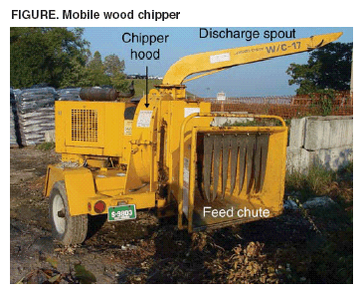
Parts of a Wood Chipper

Slide 3
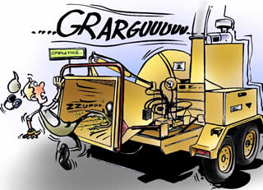
Wood Chipper Accidents

Slide 4
Injury Statistics (1992 – 2002)
United States
31 Work-Related Deaths
An average of 204 injuries per year
An estimated total of 155 amputations

Slide 5
Common Wood Chipper Accidents
Caught-By Hazard
Workers feeding material into self-feeding wood chippers are at risk of being fed through the chipper knives if they reach or fall into the in-feed hopper or become entangled in branches feeding into the machine.
Struck-By Hazard
Workers are at risk of being struck by unlatched, improperly secured, or damaged or improperly maintained hoods that may be thrown from the wood chipper after contacting the rotating chipper knives.

Slide 6
Actual Wood Chipper Accident
A worker worked for tree service and was helping clear brush in subdivision.
Shortly before 5 p.m., the worker got up onto a jammed wood chipper as it ran. Witnesses said he tried to kick at the jammed limbs and the chipper caught his foot and pulled him in. He was pronounced dead at the scene.

Slide 7
Actual Wood Chipper Accident
An immigrant from Guatemala working for a tree-cutting service was sucked into a wood chipper.
The tree service was clearing land behind a home. The owner was up in a tree chopping off limbs and dropping them to the worker below, who was putting them into a commercial wood chipper.
When the owner heard the wood chipper stop operating, he climbed down to investigate.
He found a gruesome scene – one of worker's hands was sticking out of the machine.
"It was an instant death," according to the coroner.

Slide 8
OSHA Regulations
1910.269 - Electric Power Generation, Transmission, and Distribution
1910.265 – Sawmills
  1910.266 - Logging Operations

Slide 9
Training
Take part in training for safe work procedures. Learn chipper safety devices and controls.
Read warning labels on machines. Different models have different features.
Machine Safety
Use chippers equipped with a “kill switch” that is easily accessible to workers.
Never stand or sit on any part of the chipper while the chipper is in operation.

Slide 10
Proper Use of a Wood Chipper
Pre-Operation
Wear close-fitting clothes, gloves without cuffs, trousers without cuts, and skid-resistant footwear. Keep clothing tucked in.
Wear a hard hat, eye protection, and hearing protection.
Make sure materials to be chipped are free from stones, metal, and other foreign objects even if the chipper is equipped with a curtain.

Slide 11
Proper Use of a Wood Chipper
Pre-Operation
Close and latch the hood covering the chipping knives before starting the machine.
Check the area around the wood chipper for tripping hazards.

Slide 12
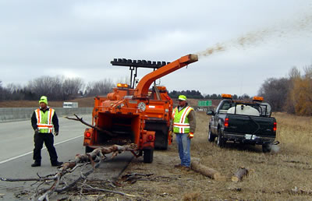
Safe operating procedures go beyond wearing protective clothing, always be aware of the surroundings.

Slide 13
Proper Use of a Wood Chipper
Operation
Use the “buddy system”: while one worker is feeding materials into the in-feed hopper, another worker should remain stationed at the feed wheel control bar.
Feed brush and limbs into the in-feed hopper butt end first.
Always feed small pieces first to open feed wheels. Follow with large pieces.

Slide 14
Proper Use of a Wood Chipper
Operation
Put short materials on top of longer materials while feeding the chipper. Use a push stick to force short or thorny brush into the chipper.
Do not load small raked-up materials like twigs and leaves into the chipper.
FOCUS ON THE JOB. ALWAYS USE COMMON SENSE

Slide 15
The Proper Way to Use a Wood Chipper

Slide 16
Think Safety
Work Safely

