Slide 1
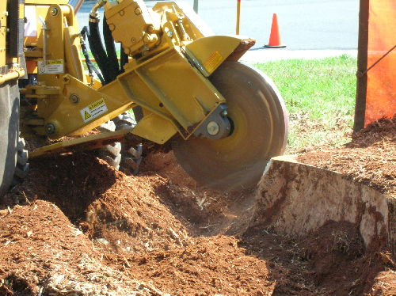
STUMP
GRINDERS
http://heartwoodtree.com/customers/107101211483425/images/Stump-grinder.JPG

Slide 2
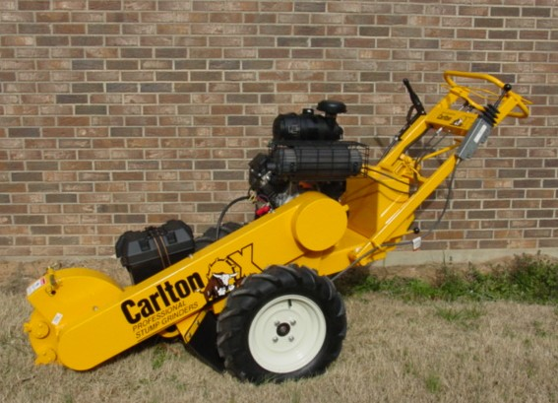
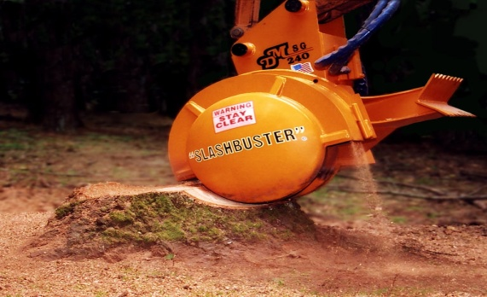
Introduction
A stump grinder can be used as a stand-alone power tool, or as an attachment for various types of equipment; they remove tree stumps by “grinding” them away with a rotating cutting wheel that chips away the wood.
Stump grinders come in a variety of sizes, ranging from the size of a lawn mover, up to the size of a small truck.
http://www.northlandchippers.com/images/sp2000left.JPG
^{1:} http://en.wikipedia.org/wiki/Stump_grinder

Slide 3
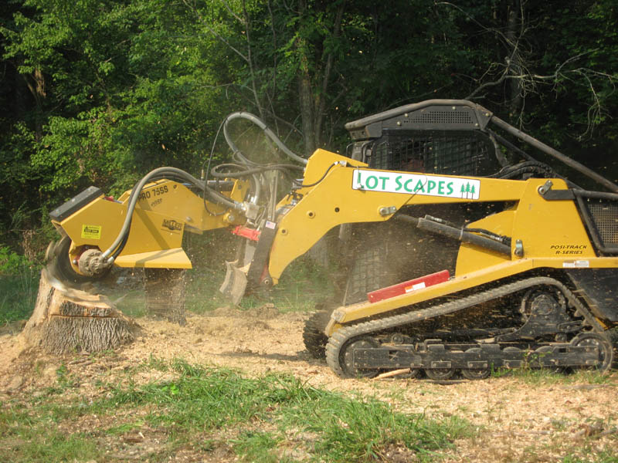
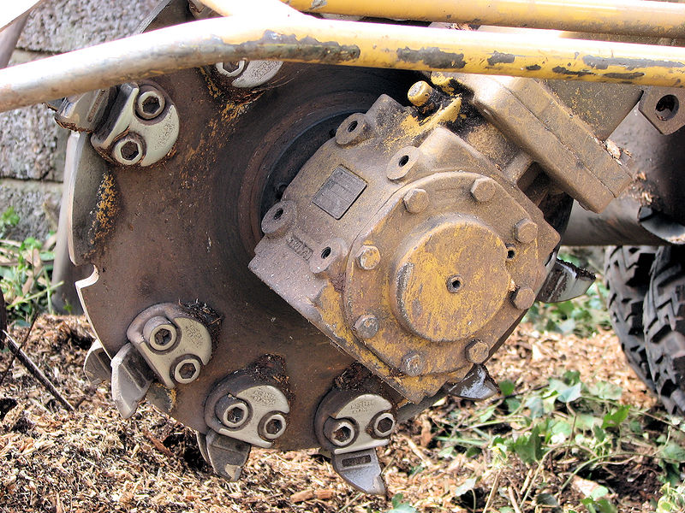
General Info
Stump grinders work by passing back and forth, across the stump, with a high-speed cutting wheel.
The cutting disk is equipped with specially designed, carbide teeth that grind the stump and roots into small chips.
Stump grinder attachments vary widely, allowing for use with almost any type of machinery.
http://www.lotscapes.com/eqp/eqp_Stump_Grinder3.jpg
http://upload.wikimedia.org/wikipedia/commons/c/c6/Stump_grinder_cutting_wheel_arp.jpg

Slide 4
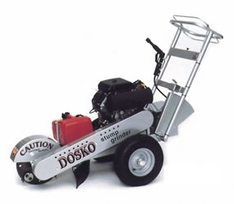
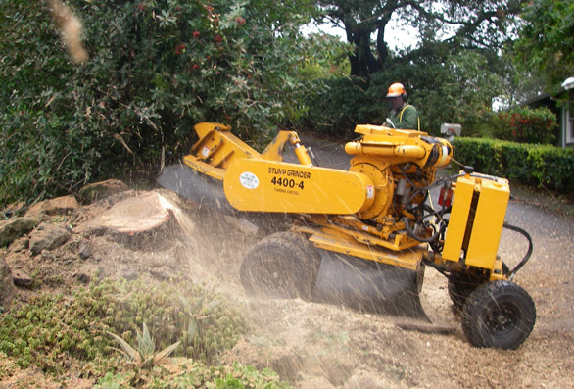
Types Of Stump Grinders
Manually/Hand Driven & Stand-Alone Machine
http://assets.newmediaretailer.com/9000/9849/web_doskomanualstumpgrinder.jpg
http://www.mandmtreeservices.com/images/stump_grinder_machine_2_28.jpg

Slide 5
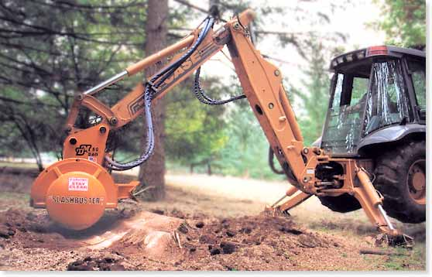
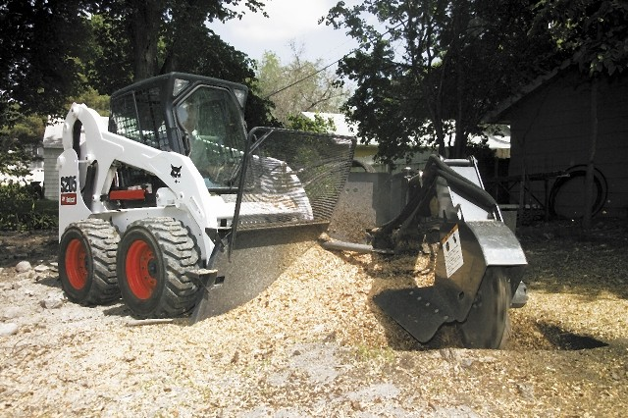
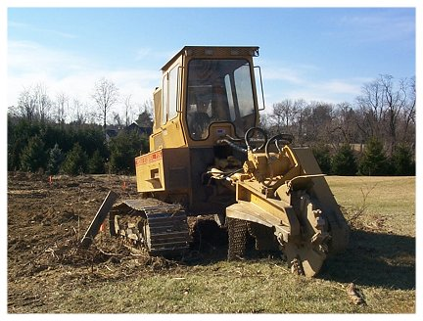
Types of Stump Grinders
Backhoe Attachment
Skid Steer Attachment
http://www.slashbuster.com/images/stumpgrinder_2.jpg
http://www.skidsteerhiresolutions.co.uk/sitebuildercontent/sitebuilderpictures/stumpgrinder.jpeg
Dozer Attachment
http://www.b4ubuild.com/photos/clearing/P0001965.jpg

Slide 6
History
Stump grinders in use today evolved from the original Vermeer Stump Grinder.
Gary Vermeer, founder of Vermeer Manufacturing Company, invented the modern stump grinder.
Note that there were mechanical stump grinders prior to Vermeer’s model.
However, these earlier forms were complex & required an entire group of people to operate.
In 1956, Gary Vermeer’s innovative design marked the first stump grinder that could be operated by a single person.
http://www.ritchiewiki.com/wiki/index.php/Stump_Cutter

Slide 7
History
Prior to the invention of the modern stump grinder, there were two main alternatives:
Manually digging up the stump and root system with mattocks and shovels
Injecting the stump with kerosene in order to burn it (this was largely unsuccessful because of a lack of oxygen inside the stump)
Another, more modern alternative is the use of nitrogen fertilizers that decompose the stump.
This method is very eco-friendly, however, it takes far too long to be feasible
http://www.ritchiewiki.com/wiki/index.php/Stump_Cutter

Slide 8
Purpose & Uses
Stump grinders are mainly used for the finishing stages of tree removal.
Stand-alone and manually-operated grinders are usually gas-powered machines.
When being used as an attachment, stump grinders typically receive their power by hooking into the hydraulic system of the machine they are attached to.
Stump grinders can grind away stump and roots that are as much as 4-8 inches underground, and even deeper with larger or specialized models.
http://ezinearticles.com/?Stump-Grinders---Use-Stump-Grinders-Safely!&id=163572
http://www.ritchiewiki.com/wiki/index.php/Stump_Cutter

Slide 9
Safety Hazards
Exposed cutting wheel
Flying debris
Generation of dust
Inhalation of suspended particles increases the risk of asthma & lung disease.
Projectiles due to potential blade failure
Potential risk to bystanders

Slide 10
Stump Grinder Accidents
In one incident, the victim got too close to the stump grinder, allowing his shirt to become entangled in the cutting wheel, and he was pulled underneath the machine.
By Carly Rothman, Sunday September 09, 2007(http://www.apwa.net/Documents/Meetings/Congress/2008/Handouts/4153.pdf )

Slide 11
Stump Grinder Accidents
One stump grinder operator required extensive surgery following severe lacerations to the instep of his left foot when it came into contact the grinding wheel.
The guard of the grinding wheel was not fitted, the brake was incorrectly adjusted, and there was no stopping device provided at the operator’s position.
http://www.hse.gov.uk/pubns/indg278.pdf

Slide 12
Stump Grinder Accidents
Accident investigated by OSHA
While an employee was grinding a stump below the road, three logs (decked above the road) rolled towards the worker.
The logs pinned and trapped the man against the stump, also breaking his pelvis in the process.
http://www.orosha.org/standards/fatals/pdf/descriptions/acc-fatalFFY06.pdf

Slide 13
Stump Grinder Accidents
Accident investigated by OSHA:
During a grinding operation, a worker attempted to clear the debris that had collected behind the cutting wheel with his foot. This was done without stopping or turning the machine off.
When the victim went to kick the debris clear, his right foot made contact with the blade.
He sustained a deep laceration on the sole of his foot and two severely fractured toes.
http://www.orosha.org/standards/fatals/pdf/descriptions/acc-fatalFFY06.pdf

Slide 14
OSHA REGULATIONS
The OSHA regulations do not specifically mention stump grinders.
However, other OSHA regulations pertaining to safe equipment operations would generally apply.
OSHA 29 CFR 1926 Construction Industry Regulations. Geneseo, IL: Reglas Press, LLC, 2007

Slide 15
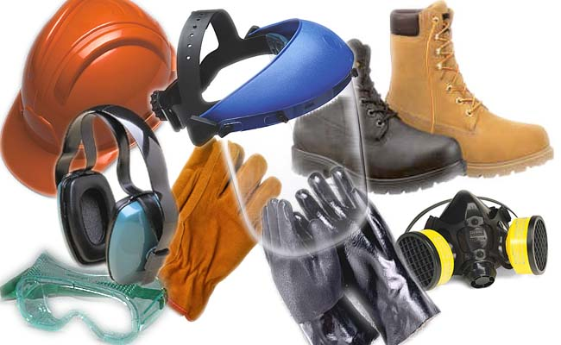
Safe Work Practices
PPE to be worn:
Goggles for eye protection.
Hardhat for falling object
protection.
Hearing protection.
Gloves for protection of hands from flying debris.
Respirators to block airborne dust/wood particles from being inhaled.
Full shield over safety glasses to cover and protect entire face from flying debris
Steel-toed boots to protect feet during equipment operation.
http://blog.fieldid.com/wp-content/uploads/ppe.jpg
OSHA 29 CFR 1926 Construction Industry Regulations. Geneseo, IL: Reglas Press, LLC, 2007

Slide 16
Safety Precautions
Because of the direction of rotation of the cutting wheel, stump grinders will not kick back
Instead, they tend to jump forward. This endangers bystanders and must be accounted for by the operator.
Crews should take care to reduce the amount of airborne particles during grinding operations or protect against them.
Respirators for all workers in the immediate area.
Keep work area watered down to prevent dust generation.
http://text.lsuagcenter.com/en/lawn_garden/home_gardening/equipment/other_lawn_garden_equipment/Use+of+Stump+Grinders.htm

Slide 17
Safety Precautions
All employees who will be operating a stump grinder must have adequate training to use the equipment safely.
Be sure to call for underground inspections and locate any underground utilities in the vicinity (e.g. gas, electricity, communications, etc).
Remember, stump grinders also grind below the surface of the ground.
When working on roads, an effective and approved traffic control management system (M.O.T. – Maintenance Of Traffic) must be in place.
http://www.landcarenetwork.org/planetFile/pdfs/SafetySolutionsJan06.pdf , page4

Slide 18
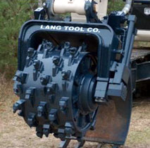
Equipment Care Maintenance:
Safe Work Practices
Never leave stump grinder unattended when running or in use.
Whenever the need arises to change the direction of the machine, it should be turned off and taken out of use beforehand.
Proper maintenance of critical
components of the machine.
Keep hydraulic fluid full
Change out worn parts; especially
the teeth or any part of the cutting
disk
http://www.langtool.com/images/grinder.jpg

Slide 19
Think safety!
Work safely!

