Slide 1
Spiders
<number>

Slide 2
Spiders
Why spiders are dangerous?
Possess venom
Toxic to humans in the quantities which can be delivered by a single bite of a single spider at one time.
the symptoms of their bites can include
necrotic wounds
systemic toxicity
death
98-99% of spider bites are harmless
http://en.wikipedia.org/wiki/Spider_bite
<number>

Slide 3
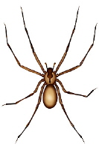
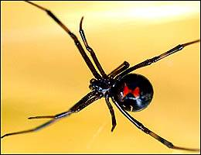
Spiders
Most dangerous spiders in the USA:
Brown Recluse
(Violin Spider)
Black Widow
<number>

Slide 4
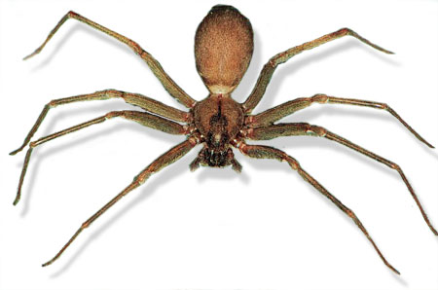
Brown Recluse
<number>

Slide 5
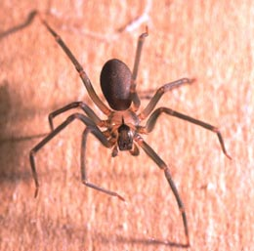
Brown Recluse
Brown Recluse:
The recluse spiders also
known as fiddle-back or
violin spiders, are a
venomous genus of spiders
known for their necrotic bite.
Violin
They are afraid of humans and will first try to run away. Biting is their last resort to escape.
<number>

Slide 6
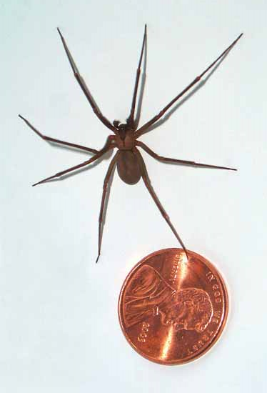
Identification
Body size: ¼ to ¾ inch.
Color: Brown
Dark violin shape located
on top of the leg attachment
region on the body.
Neck of the violin pointing
backward toward the
abdomen.
<number>

Slide 7
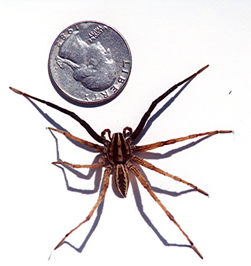
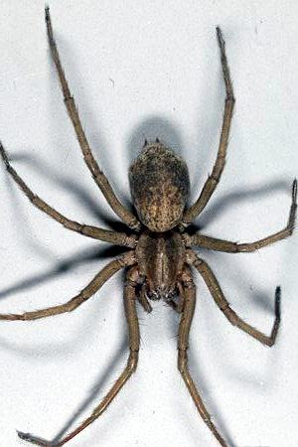
Harmless Brown Recluse Look-a-Likes
Wolf Spider
Southern House Spider
<number>

Slide 8
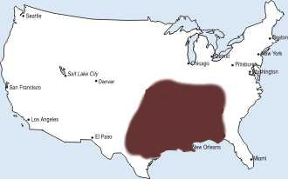
Range of the Brown Recluse
The South Eastern region of the United States.
<number>

Slide 9
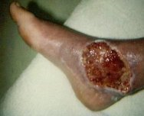
Symptoms
Pain may vary from not severe to severe.
Bite becomes red within several hours.
Swelling occurs around the bite.
Skin hardening around the bite.
Fever, shivering, and nausea.
Bite area grows into an ulcer with blue or gray border.
1.5 to 2.75 inches across.
Deep pain.
<number>

Slide 10
Black Widow Spider
<number>

Slide 11
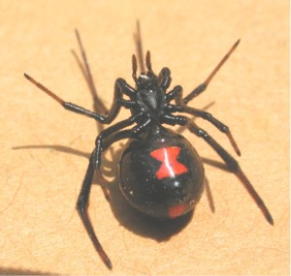
Identification
Female Black Widow is shiny black.
Red hourglass marking
under abdomen.
Abdomen marking may be
yellowish orange to dark red
and the shape may range from
an hourglass to just a dot.
Body of adult female is about ½ an inch long.
<number>

Slide 12
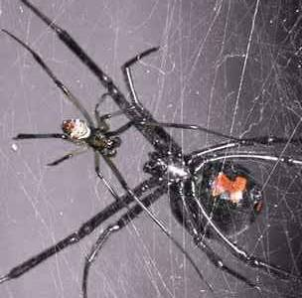
Male vs. Female
Male
Harmless.
About 1/3 the size of female.
Thinner legs and body.
Red marking almost invisible.
Female is dangerous as
described in the following slides…
<number>

Slide 13
Symptoms
The bite of the black widow may be painful or it may go unnoticed.
Skin may show 1 or 2 bite marks.
Swelling around the bite area.
Pain progresses into the abdomen and back of victim.
Severe cramping or rigidity may occur in stomach muscles.
<number>

Slide 14
Symptoms Continued
Nausea
Profuse perspiration
Tremors
Labored breathing
Restlessness
Increased Blood pressure
Fever
The pain from the bite will usually persist for the first 8-12 hours.
Symptoms may continue for several days.
<number>

Slide 15
Range of the Black Widow Spider
Shown in the yellow regions
<number>

Slide 16
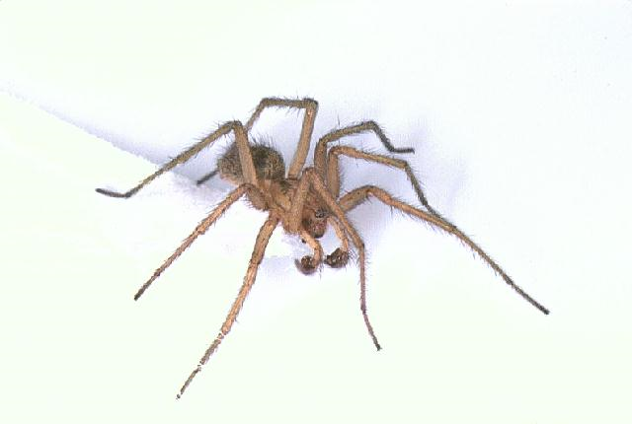
Hobo Spider
<number>

Slide 17
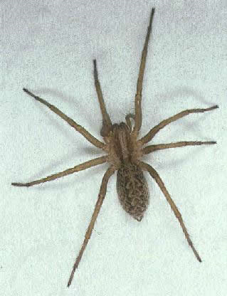
Identification
Color: Brown to dark brown
Size: 12 to 18 mm in length
Legs have short hairs
Males have two large palps that
look like boxing gloves,
often mistaken for fangs.
Abdomens have several chevron
shaped markings ( V marks).
Females have smaller palps than males
Females have larger abdomen than males.
<number>

Slide 18
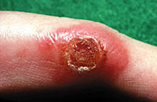
Symptoms
Severe headaches
Nausea
Vomiting
Soreness
Temporary memory loss
Vision impairment
Flu-like symptoms
Bone marrow failure may occur if not addressed
<number>

Slide 19
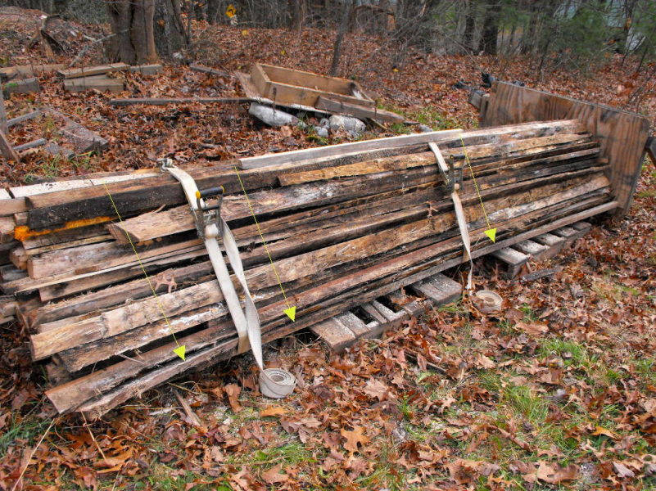
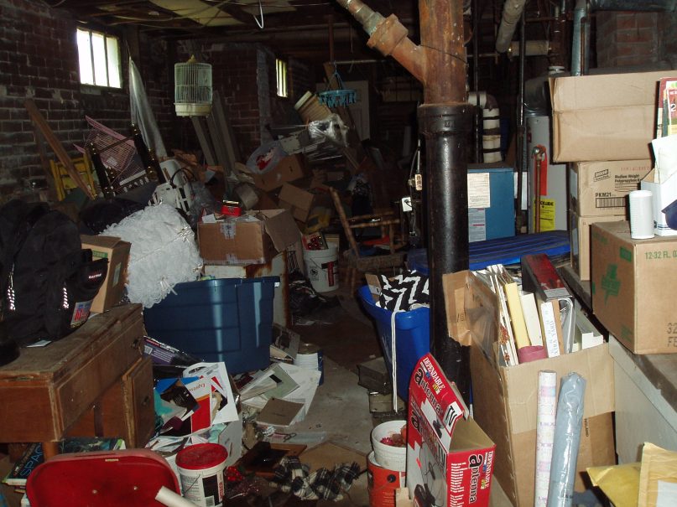
Habitat for All Spiders
Outdoors-
Woodpiles, rubble piles,
under rocks, in hollow
stumps, in rodent burrows,
sheds, and garages.
Indoors-
Undisturbed, dark,
and cluttered areas
such as basements and
crawl spaces.
<number>

Slide 20
Treatment for All Spider Bites
Clean the bite with soap and water.
Apply ice to the bite to slow absorption of the venom.
Elevate and immobilize the extremity.
Capture the spider for identification (if possible).
Seek medical attention immediately.
May need hospitalization.
<number>

Slide 21
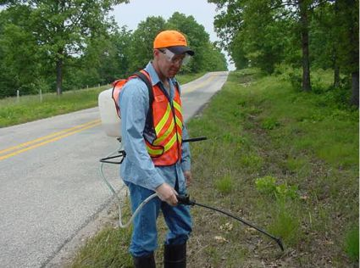
Prevention
Wear PPE
Wear long pants, socks,
gloves, and long-sleeved
shirts.
Just In Time delivery
(reduces spider habitat).
Use insect repellents that
contain DEET or Picaridin.
Check clothing before use, especially boots.
Keep work area free and clear of clutter and debris.
<number>

Slide 22
OSHA 1926.51 OSHA 1926.250
”Vermin control”
Every enclosed workplace shall be so constructed, equipped, and maintained, so far as reasonably practicable, as to prevent the entrance or harborage of rodents, insects, and other vermin. A continuing and effective extermination program shall be instituted where their presence is detected.
“House Keeping”
Storage areas shall be kept free from accumulation of materials that constitute hazards from tripping, fire, explosion, or pest harborage.
**No OSHA investigations of fatalities have been conducted that related to spiders**
<number>
Notes:
<number>

Slide 23
Think Safety
Work Safely
<number>

