Slide 1
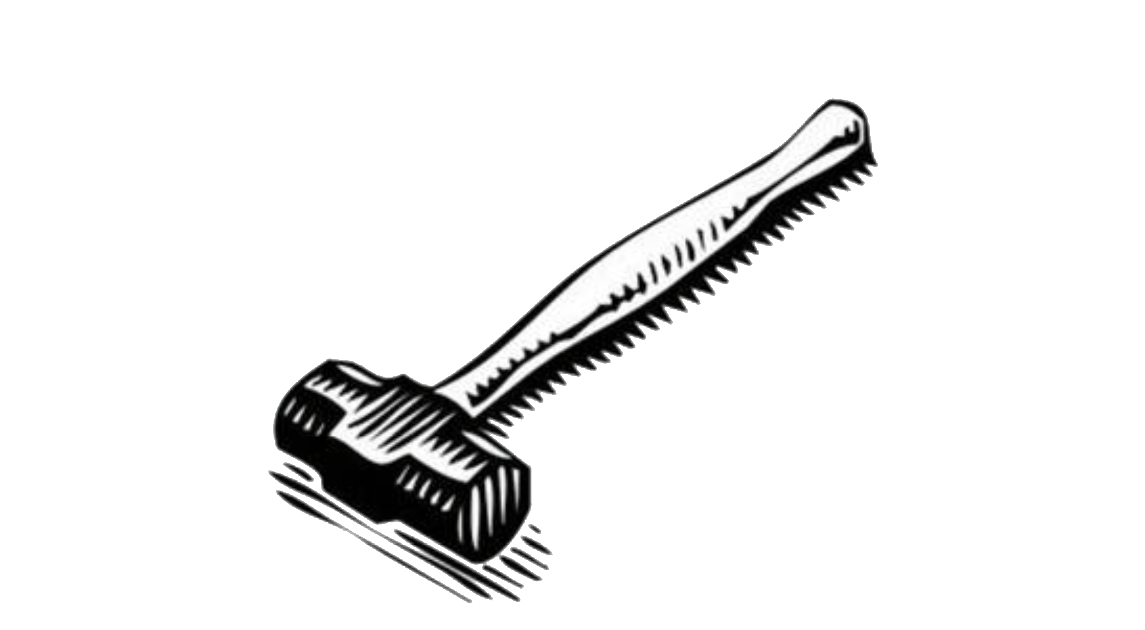
Sledge Hammers
<number>
http://newpathcenter.blogspot.com/

Slide 2
What are Sledge Hammers?
Sledge hammers consist of a handle and a heavy head that is widely used for breaking up or demolishing structural components or moving heavy items small distances
<number>

Slide 3
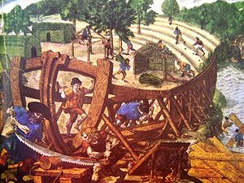
Origins
First use was in the ship building industry.
Ships were built on large wooden sledges held by chocks.
When the ships were ready to launch large hammers were used to remove the sledges.
An expedition's shipwrights building a brigantine, 1541
http://en.wikipedia.org/wiki/Shipbuilding
<number>
http://en.wikipedia.org/wiki/Hoist_(device)

Slide 4
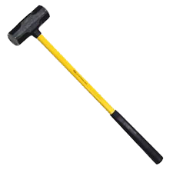
Specifications
Usually weigh from 8-20 lbs
Handle: Wood or Fiberglass
  Usually 3 feet long
Head: Forged Steel, rubber, or wood
  Two parts:
    the cheek (side)
    face (hammering ends)
Finish: Lacquered or Painted
Grips: Rubber, Taped or None
Lightweight: specialty sledge hammers
  Have a chisel or spike to cut or penetrate while hammering
Heavyweight: typical sledge hammers found in construction
<number>
http://artofmanliness.com/2009/09/29/how-to-use-a-hammer/

Slide 5
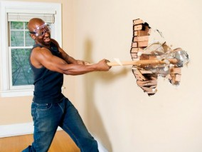
Industry Uses
Demolition, driving, or dislodging
Home Improvement
Driving objects: posts, large nails or pins.
Demolition: breaking through walls
  Masonry Walls
  Gypsum Board Walls
  Drywalls
Dislodging: remove stuck objects
http://www.diylife.com/category/living-rooms/page/6/
<number>
web.dcp.ufl.edu/hinze/AA-srPPT-2008/Sledgehammers-27.ppt

Slide 6
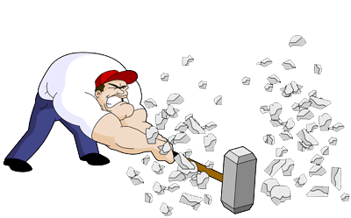
People who use Sledge Hammers
Most Construction Trades:
  Electrician
  Site Work
  Mechanical
  Masonry
  Demolition
  Shell Contractors
  Steel/Iron Workers
<number>
http://www.bradfitzpatrick.com/weblog/169/strength-illustration-friday/

Slide 7
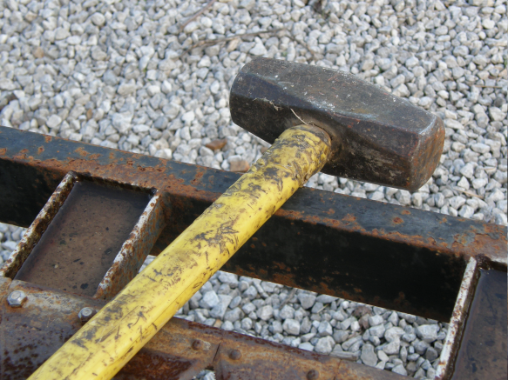
Sledge Hammer Maintenance
Hazards posed by hand tools result from misuse and improper maintenance
Always clean before storage
Make sure the hammer is being used for the right job
Do not leave hammer in the sun
  Wood can become cracked and dry
Do not use:
  A hammer with a cracked or loose handle
  A hammer with a chipped or cracked face
  A hammer with a damaged or mushroomed head
<number>

Slide 8
Safety Concerns & Precautions
Concerns:
  Most common injuries:
    Broken bones & Hand injuries
    Struck by:
      Debris in eyes and ears
      Metal shards
    Muscle pulls/Back problems
    Losing balance from weight of sledge hammer
Precautions
  Stretch well and do not wear loose-fit clothing
  Use appropriately sized hammer
  Inspect equipment
    Cracked or chipped handles or heads
  Inspect Work Area
    Check for hazards
http://www.hammernet.com/safety.htm
<number>

Slide 9
Nature of Accidents
Most injuries directly related to hammers and sledges are minor and in almost all cases are not life threatening.
Deaths related to hammers and sledges are usually not actually caused by the hammer or sledge itself, but by other objects collapsing or breaking after being struck by a hammer or sledge.
<number>
Notes:
<number>

Slide 10
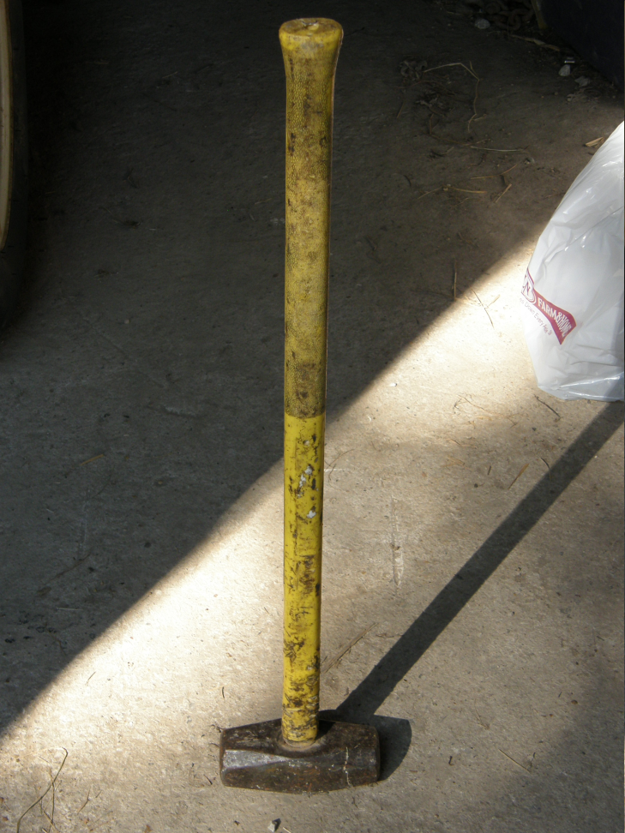
Statistics on Fatalities
There were 38 deaths related to sledges.
<number>
(Extracted from OSHA from 199`0 to 2009.)
Notes:
<number>

Slide 11
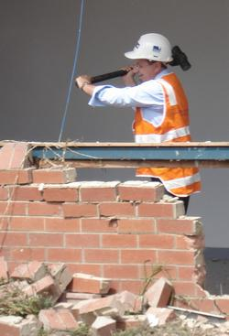
Fatality with a Sledge Hammer
A worker was trying to straighten out a bent rear section of a dump truck. He propped open the tailgate with a piece of wood and was hitting the metal with a sledge hammer. The piece of wood became dislodged and the heavy metal tailgate closed on the worker, crushing him between the truck and the tailgate, resulting in his death.
<number>
Source: Extracted from OSHA Accident Investigation Data 1990-2009

Slide 12
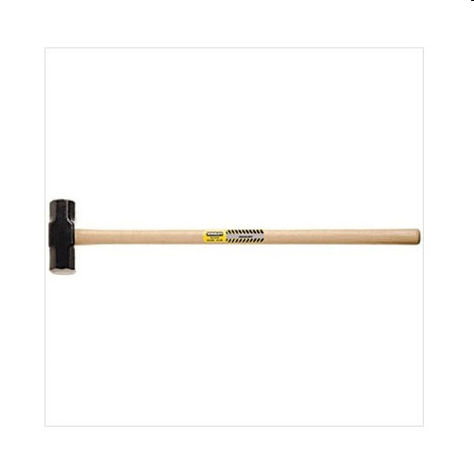
Fatality with a Sledge Hammer
A man was preparing to repair a water well when he was using a sledge hammer to pound a steel stake into the ground. A small fragment of steel from the hammer broke away and penetrated his chest. In spite of rescue efforts, he died at the scene.
<number>

Slide 13
OSHA1926.301
General Requirements
(a) Condition of Tools. All hand and power tools and similar equipment, whether furnished by the employer or the employee, shall be maintained in a safe condition.
(c) Personal protective equipment. Employees using hand and power tools and exposed to the hazard of falling, flying, abrasive, and splashing objects… shall be provided with the particular personal protective equipment necessary.
<number>
web.dcp.ufl.edu/hinze/AA-srPPT-2008/Sledgehammers-27.ppt

Slide 14
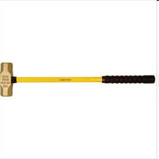
OSHA1926.301
Hand Tools
(a) Employers shall not issue or permit the use of unsafe hand tools.
(c) Impact tools, such as drift pins, wedges, and chisels shall be kept free of mushroomed heads.
(d) The wooden handles of tools shall be kept free of splinters or cracks and shall be kept tight in the tool.
<number>
web.dcp.ufl.edu/hinze/AA-srPPT-2008/Sledgehammers-27.ppt

Slide 15
OSHA Regulations
The wooden handles of hammers should be kept free of splinters and shall be kept tight in the head of the hammer.
Impact tools, such as sledge hammers, are considered unsafe if they have mushroomed or have chipped heads. The heads could shatter on impact, sending sharp fragments flying into the air.
<number>

Slide 16
Safety Procedures
A clear work area free of obstruction while swinging.
The stability of the handle and head should be checked before each use.
Most importantly, always be aware of the site surroundings and possible hazards when using hammers and sledges.
<number>
http://www.wisegeek.com/what-is-a-sledgehammer.htm

Slide 17
How to Use a Sledge Hammer
Use both hands when swinging the entire torso.
Proper use: hit the target square and level.
  Keep a clear work area free of obstruction while swinging
Use the proper P.P.E.
  Wear heavy duty gloves.
  Always wear safety glasses.
  Wear steal-toed shoes.
To avoid injury:
  Keep feet spread shoulder-width apart
  Swing hammer level (whether downward to drive a pin or laterally for demolition)
  Alternate shoulder to reduce wear and tear on muscles and joints
<number>
http://www.rd.com/sledge-hammer/article12945.html

Slide 18
Think Safety
Work Safely
<number>

