Slide 1
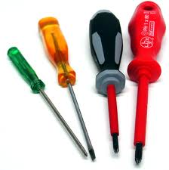
Screwdrivers

Slide 2
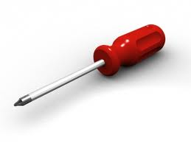
Description
A screwdriver is a hand tool for turning a screw, consisting of a handle attached to a long, narrow shank, usually of metal, which contains a tip that fits into the head of a screw.
Source: “Screwdriver.” http://dictionary.reference.com/browse/screwdriver

Slide 3
Background Information: History
The first screwdriver traces its roots to 15th century Germany.
First documented in The Medieval Housebook of Wolfegg Castle
Originally called a “screw-turner”
Originally used to secure armor and firearm parts
Seen as a luxury tool due to expensive costs to produce screws
The Industrial Revolution brought about rapid advances in manufacturing screws.
Source: Rybczynski, Witold (2000), One Good Turn: A Natural History of the Screwdriver and the Screw, Toronto: Harper Flamingo Canada; pgs. 53-54

Slide 4
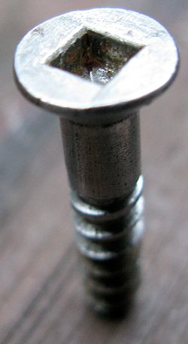
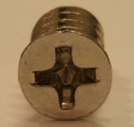
Background Information: Modern Advances
1907- Peter L. Robertson patented the first socket-headed screw and screwdriver.
Gave way to the modern screwdriver
1936- Henry Phillips invented an improved form of the Robertson screw and screwdriver.
Deep-socket screw and screwdriver with a cruciform known as the Phillips Screw and Phillips Screwdriver
Still the most popular screw/screwdriver combination used today
Source: Rybczynski, Witold (2000), One Good Turn: A Natural History of the Screwdriver and the Screw; pgs. 80-83
Close-up of a Robertson screw
A modern Phillips screw

Slide 5
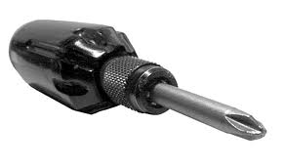
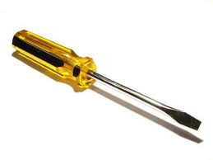
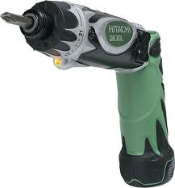
Background Information: Types of Screwdrivers
Phillips-head Screwdriver
Two widely used hand-held screwdrivers are today:
Flathead
Phillips-head
Electric drills with Phillips-head and flathead drill bits can be used for faster installation/removal.
Flathead Screwdriver
Electric drill with Phillips-head drill bit attached

Slide 6
Components
A screwdriver consists of four parts:
1) handle
2) shank
3) blade
4) tip
Source: “Parts of a Screwdriver.” Toolmanship: How to use a Screwdriver. http://artofmanliness.com/2010/02/18/toolmanship-how-to-use-a-screwdriver/

Slide 7
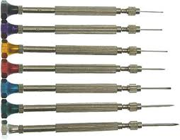
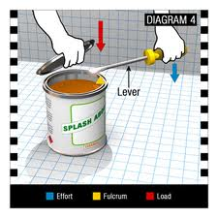
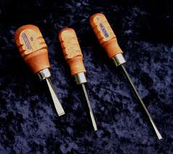
Standard Usage
Jeweler’s screwdriver set
Tightening and loosening screws
Different sizes and drive types are used by jewelers and gunsmiths.
Flathead screwdrivers are often used for opening paint cans.
Flat-head screwdriver opening a paint can
Gunsmith’s screwdriver set

Slide 8
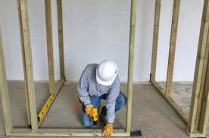
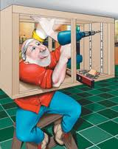
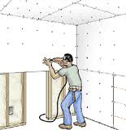
Relevance to Construction
Mainly used for tightening and loosening screws in wood framing, hanging drywall, cabinetry, etc.
Use electric drills with Phillips-head and flathead drill bits for faster assembly.
Use flathead screwdriver for opening paint cans.

Slide 9
Typical Hazards
Improper use:
Prying, punching, chiseling
Incorrect size
Incorrect type
Usage around live conductors/circuits
Using a damaged screwdriver
Bent shank
Broken tip
Damaged handle
Sources: Safety Hints: Screwdrivers. http://www.osh.dol.govt.nz/order/catalogue/archive/screwdrivers.pdf
OSH Answers (Screwdrivers)- http://www.ccohs.ca/oshanswers/safety_haz/hand_tools/screwdrivers.html

Slide 10
Statistics
There were 13 fatal OSHA cases involving screwdrivers between 1990-2009
9 of which the victim was electrocuted
Other
SOURCE: Extracted from OSHA Accident Investigation Data 1990-2009

Slide 11
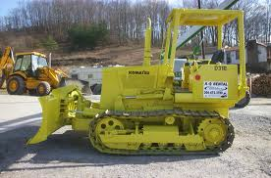
Fatality Case involving a Screwdriver
A worker was standing in front of the left side track of a Komat’su track dozer. He touched the contact points on the starter with a screwdriver. The machine was in forward high gear when the engine started and moved forward, crushing and killing him under the machine’s track.
SOURCE: Extracted from OSHA Accident Investigation Data 1990-2009
A Komat’su Model D-31-E, similar to the track dozer which killed the worker.

Slide 12
Fatality Case involving a Screwdriver
Two workers were installing three current transformers in an energized 480-volt, 800-amp panelboard. One worker used a screwdriver to connect the two halves of a current transformer around the bus bar when an electrical fault occurred. Both employees received second and third degree burns over 80% of their bodies as a result of the electric arc and explosion. One worker died and the other was hospitalized.
SOURCE: Extracted from OSHA Accident Investigation Data 1990-2009

Slide 13
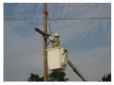
Fatality Case involving a Screwdriver
Two workers were on an insulated aerial lift, removing a bolt from the top of a utility pole. One of the workers climbed out of the bucket and onto the cross arm, while the other stayed in the bucket. Using a hammer and a screwdriver, he punched the bolt until he could pull it out by hand. When he pulled the bolt free, his hand contacted an energized jumper. He received an electric shock and his clothing ignited. He died from his injuries.
SOURCE: Extracted from OSHA Accident Investigation Data 1990-2009
Worker in an aerial lift working on utility pole

Slide 14
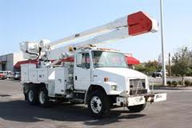
Fatality Case involving a Screwdriver
A worker was standing on the rear of a conveyor-type boom truck. He was using a screwdriver to manipulate the boom controls since the joystick for the control was broken. As he rotated the boom, it contacted a 7200-volt overhead power line. He received an electric shock, descended from the truck bed, and died from the electrical shock.
SOURCE: Extracted from OSHA Accident Investigation Data 1990-2009
Freightliner FL80 truck with bucket

Slide 15
Fatality Case involving a Screwdriver
A company was moving a form traveler which was used for pouring concrete, when electrical power was lost to the machine. The superintendent decided to test the electrical system. The probes for the tester were not of sufficient length to reach into the cavity to make contact with the conductor. He inserted a screwdriver into the cavity which was used as an extension for the probe. He contacted the energized screwdriver with the back of his hand and was electrocuted.
SOURCE: Extracted from OSHA Accident Investigation Data 1990-2009

Slide 16
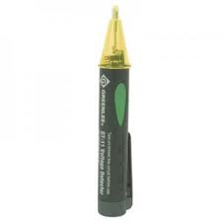
Fatality Case involving a Screwdriver
Two workers were helping to renovate a building by installing new electrical wiring. One worker had informed the other that one of the metal conduits was loose, and it was energizing the other conduits in the area. The worker entered the attic area with a voltage detector to identify any energized conduits or wires.
SOURCE: Extracted from OSHA Accident Investigation Data 1990-2009
Continued
Greenlee GT-11 Voltage Detector, similar to the one used by the victim

Slide 17
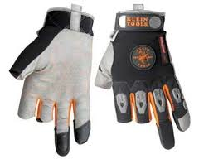
The worker had non-insulated tools (a screwdriver and a 9-inch side cutter), and he was wearing journeyman electrical gloves which did not cover two fingers and the thumb of each hand. As he was crawling in the limited attic space, his chest and upper extremities made contact with an energized conduit or wire, and he was electrocuted.
SOURCE: Extracted from OSHA Accident
Investigation Data 1990-2009
Klein Journeyman electrical gloves with thumbs, index and middle fingers exposed, similar to the gloves the victim was wearing.

Slide 18
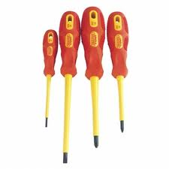
OSHA Regulations
There is NO OSHA regulation pertaining specifically to screwdriver safety.
However, 1910.335(a)(2)(i) states: “When working near exposed energized conductors or circuit parts, each employee shall use insulated tools or handling equipment if the tools or handling equipment might make contact with such conductors or parts.”
This extends to the use of screwdrivers near live conductors/circuits.
Source: OSHA Regulations (Standards-29 CFR). http://www.osha.gov/pls/oshaweb/owadisp.show_document?p_table=STANDARDS&p_id=9912
Screwdrivers with insulated handles

Slide 19
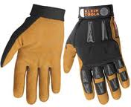
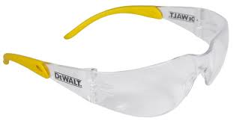
Personal Protective Equipment
Use insulated gloves to avoid hand injuries.
Use safety glasses when using an electric screwdriver.

Slide 20
Safety Procedures
Always match the screwdriver to the screw head, both in terms of size and type.
Use a screwdriver with a tip width that is the same width as the screw head.
Keep the screwdriver handle clean.
Greasy handles can cause injury from unexpected slippage.
Do not lean or push on a screwdriver with any more force than necessary.
Do not use defective screwdrivers.
If work must be carried out on electronic equipment, use screwdrivers that have insulated handles.
Source: OSH Answers (Screwdrivers)- http://www.ccohs.ca/oshanswers/safety_haz/hand_tools/screwdrivers.html

Slide 21
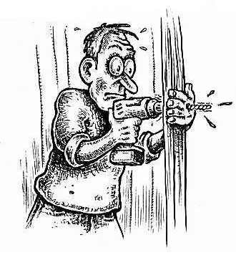
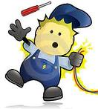
Safety Procedures
Do not hold the screw stock in one hand while using the screwdriver with the other. Pre-drill screw holes when possible
Slippage could cause serious injury to the hand, especially with electric screwdrivers.
Do not use a screwdriver to check if an electrical circuit is live.
Source: OSH Answers (Screwdrivers): http://www.ccohs.ca/oshanswers/safety_haz/hand_tools/screwdrivers.html

Slide 22
Work Safely
Think Safety

