Slide 1
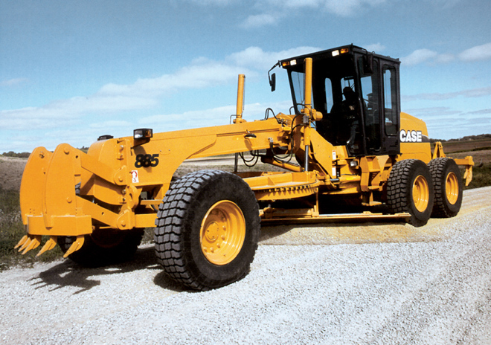
Motor Graders

Slide 2
Description
Motor Grader- a construction machine with a long blade used to create a flat surface.
Also referred to as: a grader, road grader, blade, or maintainer
http://en.wikipedia.org/wiki/Grader

Slide 3
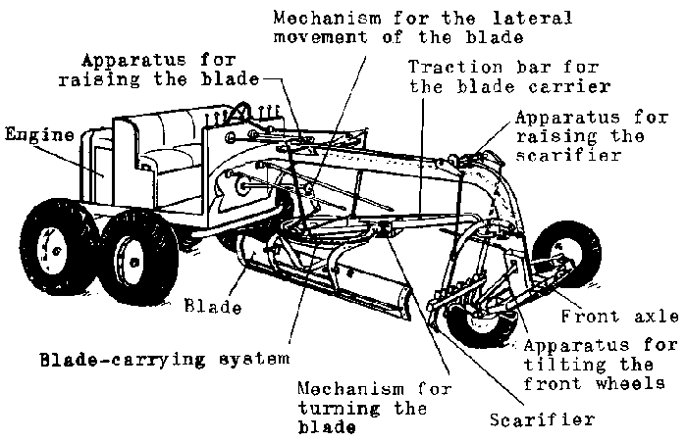
Description/Components
Typical models have three axles, with the engine and cab situated above the rear axles at one end of the vehicle and a third axle at the front end of the vehicle, with the blade in between.

Slide 4
History
1918 Grader
Since 1903 dirt and gravel roads have been built using graders. Two entrepreneurs built the first Russell grader. Not long afterwards, commercial manufacturers like Caterpillar and John Deere began to make them by mass production.
http://www.heavyequipmentschool.com/?p=149

Slide 5
Uses
“Blue topping”- in road or grading work the surveyor places stakes and paints their tops blue to represent the required elevation.
Graders are typically used to refine the grading that is started by heavier equipment like dozers and scrapers.
Fine Grading
www.buyerzone.com/.../rbic-reengineered.html

Slide 6
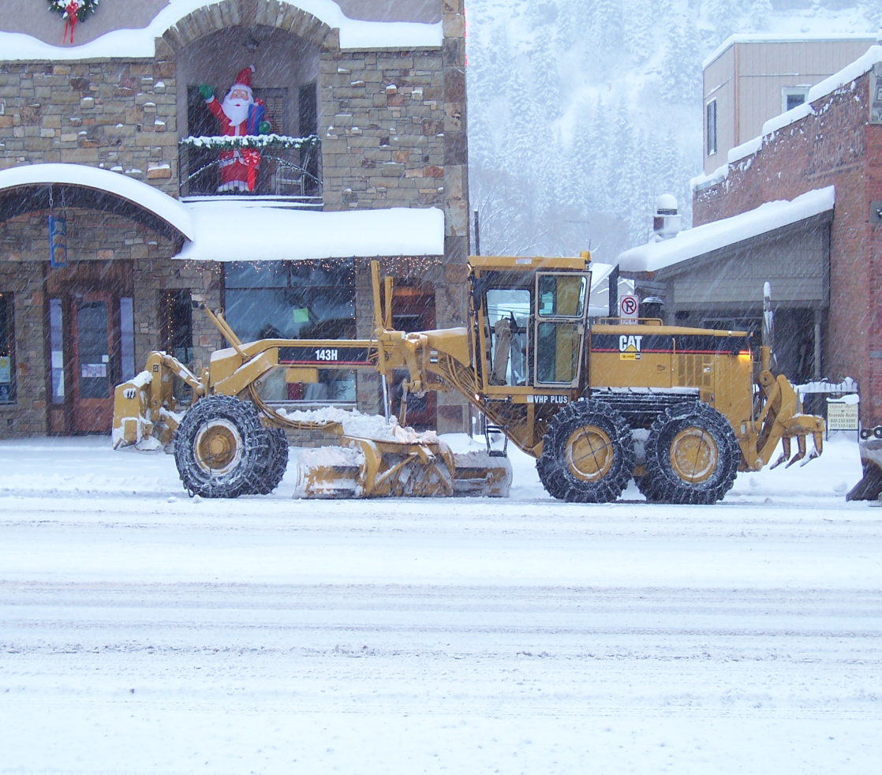
Less Common Uses
Snow Removal
Underground Mining
Farm work
http://en.wikipedia.org/wiki/Grader

Slide 7
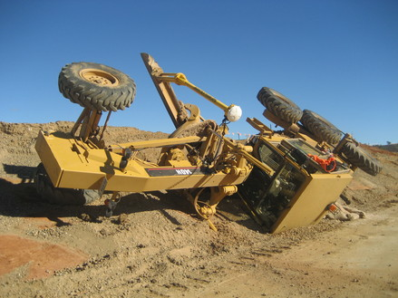
Hazards
Roll over
Struck by hazards
Pinch points
Slips and falls
Hitting Unknown Objects
http://www.contractjournal.com/blogs/digger-blog/assets_c/2009/06/Picture%20002-thumb-439x329-37661.jpg

Slide 8
Fatalities
From 1990 thru 2009 there were 78 construction worker deaths investigated by OSHA that pertained to the operation, use, or presence of a motor grader.
The majority (nearly 63%) were workers on the ground who worked near the graders.
Source: Extracted from OSHA Accident Investigation Data 1990-2007

Slide 9
Nature of Grader Accidents

Slide 10
Nature of Grader Movement

Slide 11
Cases
The operator prepared to begin backing up the grader. Since the grader was missing the factory installed side rearview mirrors, he looked to the rear over his shoulders in which he did not see anyone and proceeded to back up the grader. A worker moved into the path of the grader from the right, and the left rear tires struck and ran over him. He suffered multiple injuries to the chest and abdomen and later died.
Source: Extracted from OSHA Accident Investigation Data 1990-2007

Slide 12
Cases
A worker was walking behind the rear of a road grader that was backing up. The reverse alarm was sounding and was audible, according to witnesses. The employee was caught on her left side by the left rear wheel of the grader and pulled under both tires. She sustained injuries to her body including head, leg, and abdominal injuries which led to her death.
Source: Extracted from OSHA Accident Investigation Data 1990-2007

Slide 13
Cases
An operator started a motor grader and left it idling in gear to let the engine and transmission oils warm up. While the machine was idling, he started to climb down from the machine. As he did this he apparently slipped and hit the accelerator pedal, causing the engine to speed up. As the motor grader started to move forward, he fell in front of the left front rear wheel and was run over. He suffered massive internal injuries and was pronounced dead.
Source: Extracted from OSHA Accident Investigation Data 1990-2007

Slide 14
Cases
A worker was directing a motor grader on how much grade to cut. After the grader passed him, he attempted to cross behind it. At the same time, the road grader backed up and ran over him. He died from internal injuries.
Source: Extracted from OSHA Accident Investigation Data 1990-2007

Slide 15
Cases
A worker was using a hand-held optic grade checking device while a coworker was operating a motor grader. The worker bent over, placing his head close to the ground to sight an elevation marker located on the side of the new road. At the same time, the operator backed up the motor grader to make another pass over the road fill that had recently been placed. As he backed up, he ran over and crushed the worker's head, killing him. The back-up alarm was inoperative.
Source: Extracted from OSHA Accident Investigation Data 1990-2007

Slide 16
OSHA Regulations
The following OSHA Regulations encompass rubber-tired self-propelled machinery as a whole although there are a few instances where motor graders are specifically mentioned.
www.finning.co.uk/.../Motor_Graders/

Slide 17
OSHA Regulations
1926.1001(a)-General. This section prescribes minimum performance criteria for rollover protective structures (ROPS) for rubber-tired self-propelled scrapers; rubber-tired front-end loaders and rubber-tired dozers; crawler tractors, and crawler-type loaders, and motor graders. The vehicle and ROPS as a system shall have the structural characteristics prescribed in paragraph (f) of this section for each type of machine described in this paragraph.
Source: 29 CFR 1926 OSHA Construction Industry Regulations

Slide 18
OSHA Regulations
1926.1001(b)-For motor graders: Operating between 0 and 10 miles per hour over hard clay where rollover would be limited to 360 deg. down a slope of 30 deg. maximum.
1926.1001(c)(1)(iii)-Recommended, but not mandatory, types of test setups are illustrated in Figure W-1 for all types of equipment to which this section applies; and in Figure W-2 for rubber-tired self-propelled scrapers; Figure W-3 for rubber-tired front-end loaders, rubber-tired dozers, and motor graders; and Figure W-4 for crawler tractors and crawler-type loaders.
Source: 29 CFR 1926 OSHA Construction Industry Regulations

Slide 19
OSHA Regulations
1926.1001(f)(2)(i)- The energy requirement for purposes of meeting the requirements of paragraph (e)(1) of this section is to be determined by referring to the plot of the energy versus weight of vehicle (see … Figure W-9 for motor graders). For purposes of this section, force and weight are measured as pounds (lb.); energy (U) is measured as inch-pounds.
Source: 29 CFR 1926 OSHA Construction Industry Regulations

Slide 20
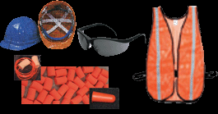
Safety Equipment
Personal Protective Equipment (PPE)
Hard Hat
Safety shoes (work boots)
Hearing and Eye Protection
Hi-visibility vest
Gloves
www.constructionsafety.ws/

Slide 21
Safety Procedures
Walk around the motor grader before operating it
Maintain 3 points of Contact with the motor grader when entering or leaving the cab.
Check the surrounding area of the motor grader, especially where grading could be hazardous.
Check the functionality of the motor grader including rear view mirrors.
Construction Industry Manufacturers Association Motor Grader Safety Manual

Slide 22
Safety Procedures
Fasten Seat Belt.
Sound Horn before starting.
Know all traffic and hand signals.
Have the motor grader serviced and maintained regularly.
Never allow someone under the influence of drugs or alcohol to operate or be in the vicinity of the motor grader.
Construction Industry Manufacturers Association Motor Grader Safety Manual

Slide 23
Think Safety
Work Safely

