Slide 1
LEAF BLOWERS
<number>

Slide 2
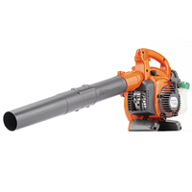
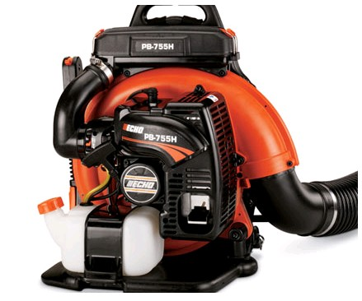
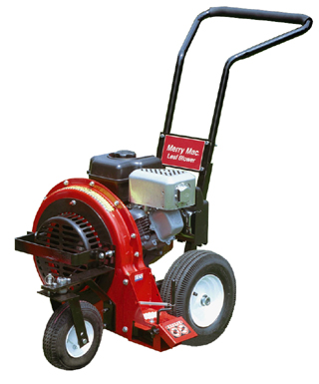
Gardening tool used to remove leaves and light debris from gardens, lawns, roofs, and roads
Used for housekeeping on the construction site
Can be hand-held, carried as a backpack, or pushed (with wheels)
Hand-held
Backpack
Pushed
<number>

Slide 3
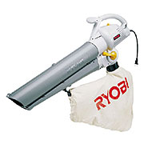
Leaf blowers typically have 2 to 4 stroke engines and a nozzle that propels air out to blow leaves
Some leaf blowers have electric motors with cords
Some leaf blowers are designed to suck leaves into a bag which is attached
According to OSHA 1926, 302, a leaf blower is categorized under Power Driven Tool¹
Electric Suction Type
1. OSHA 29 CFR 1926 Construction Industry Regulations. Geneseo, IL: Reglas Press, LLC, 2007.
<number>

Slide 4
A 2-stroke leaf blower engine produces 90-100 dB of sound nearby and 70-75 dB at a distance of 50 feet from the engine²
Can cause hearing problems for the operator using the leaf blower
Can cause hearing problems to nearby residents if the leaf blower is frequently used in the same area
2. http://www.nonoise.org/quietnet/cqs/leafblow.htm
<number>
Notes:
<number>

Slide 5
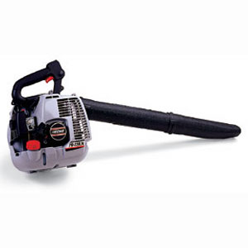
Emits (gas-powered) carbon monoxide and hydrocarbons²
Produces particulates in air²
Produces (gas-powered) as much smog as 17 cars²
Smog causes asthma, bronchitis and other lung diseases, reducing the ability to fight against infections
3. http://www.nonoise.org/quietnet/cqs/leafblow.htm
<number>
Notes:
<number>

Slide 6
There were two leaf blower-related fatalities reported to OSHA from 1990 thru 2009
5. OSHA Construction Worker Fatality Data (1990-2007).
<number>

Slide 7
A worker was using a leaf blower on the roof of an apartment building 20 feet above the ground. He slipped and fell onto the sidewalk below. He was transported to the hospital but died from massive head and body trauma.⁵
Proposed Safety Measures:
As per OSHA 1926(501), employees working at a height of more than 6 feet above a lower level should be protected from falling using guard rails, safety nets or personal fall arrest systems.
5. OSHA Construction Worker Fatality Data (1990-2007).
<number>

Slide 8
A worker was on a tailgate and was pulling a 8 horsepower leaf blower along. He was jarred from the truck and hit his head on the ground, suffered a severe head injury, and later died at an area hospital. ⁶
5. OSHA Accident Investigation Data (1990-2007).
<number>

Slide 9
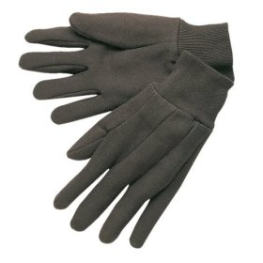
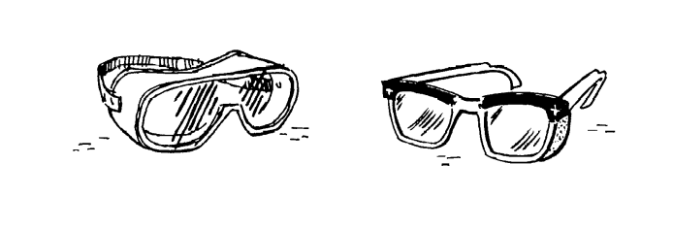
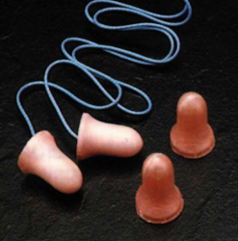
OSHA 1926, Subpart E, PPE⁴ requires:
Gloves for protection in case of fuel
spill or fire and contact with hot engine.
Goggles for eye protection
from dust and smoke
Ear plugs or head phones for
protection against noise
4. OSHA 29 CFR 1926 Construction Industry Regulations. Geneseo, IL: Reglas Press, LLC, 2007.
<number>

Slide 10
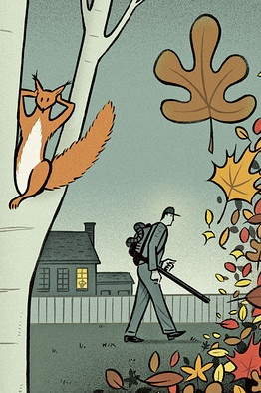
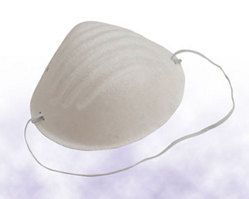
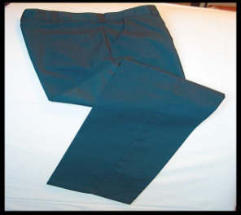
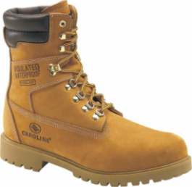
Breathing protection from dust
and smoke
Body protection in case of fuel
spill or fire
<number>

Slide 11
Carefully read and follow instruction manual
Check the fuel (check for leaks) before use
Keep appropriate oil level as indicated in manufacturer’s label
Start blower away from fuel container
During refueling, turn the leaf blower off and do not smoke
OSHA1926.302(c)(1) – All fuel powered tools shall be stopped while being refueled, serviced, or maintained, and fuel shall be transported, handled, and stored in accordance with Subpart F of this part.⁶
<number>

Slide 12
Use personal protective equipment such as gloves, goggles, ear plugs, and masks or any other type of breathing protection
Make nearby workers aware that the leaf blower will be used
Do not blow toxic substances or chemicals
Do not direct the leaf blower toward other people
<number>

Slide 13
Provide ventilation if the leaf blower is being used in interior space and check for the concentration of toxic gases
OSHA 1926.302(c)(2) – When fuel-powered tools are used in enclosed spaces, the applicable requirements for concentrations of toxic gases and use of personal protective equipment, as outlined in Subparts D and E of this part, shall apply.⁷
Use fall protection system when using on roof or any surface above 6 feet from the lower level
7. OSHA 29 CFR 1926 Construction Industry Regulations. Geneseo, IL: Reglas Press, LLC, 2007.
<number>

Slide 14
Use a fall protection system when using the leaf blower on a roof or any surface above 6 feet from the lower level
OSHA1926.501(b)(1) – If an employee is on a walking /working on surface or edge that is 6 feet or more above a lower level, shall be protected from falling by guard rail, safety net or personal fall arrest system.⁸
OSHA1926.501(b)(2) (i)– If an employee working at a leading edge that is 6 feet or more above a lower level, shall be protected from falling by guard rail, safety net or personal fall arrest system.⁸
8. OSHA 29 CFR 1926 Construction Industry Regulations. Geneseo, IL: Reglas Press, LLC, 2007.
<number>

Slide 15
<number>

