Slide 1
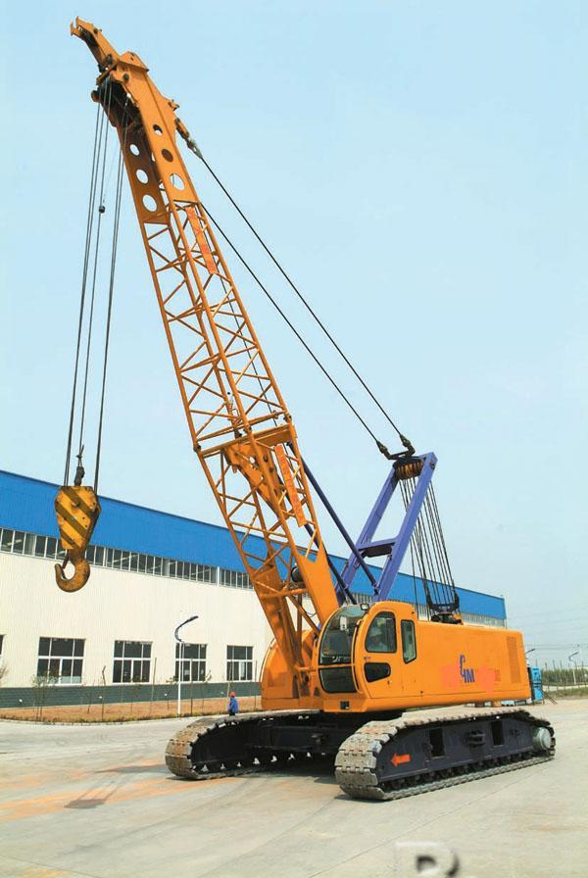
Lattice Boom Cranes
http://www.biztrademarket.com/User/182617/bb/pr70-crawler-crane_cdh.jpg

Slide 2
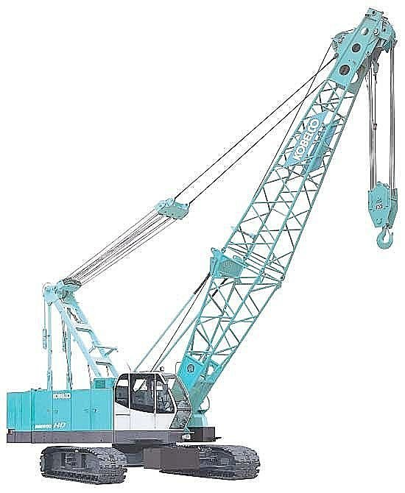
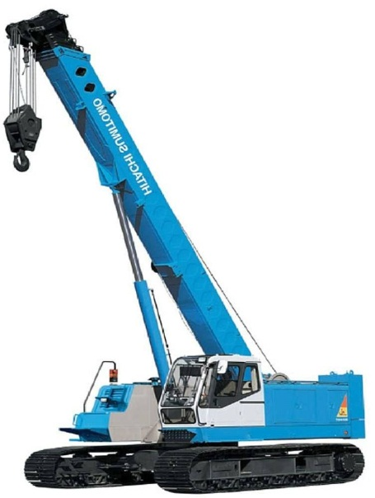
Lattice Boom Cranes
Specific type of mobile crane used in construction
Identifiable by a boom that is composed of a web-like structure
Typically taller than alternative hydraulic type mobile cranes
Lattice Boom Vs. Hydraulic Boom
http://img.directindustry.com/images_di/photo-g/crawler-crane-403618.jpg

Slide 3
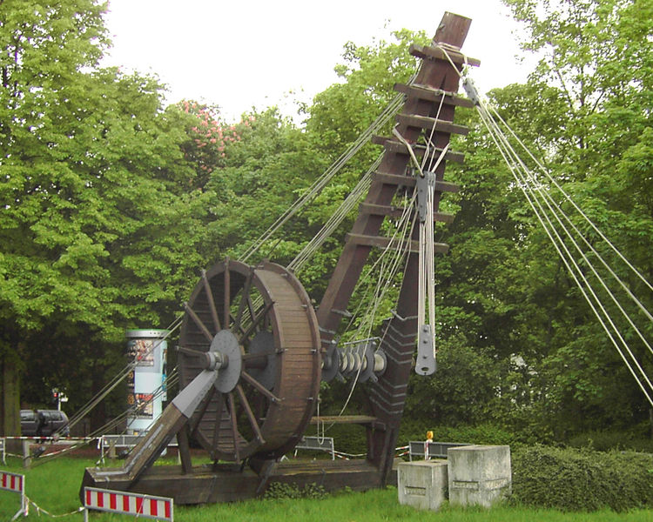
A Brief History of Cranes
Greeks are credited with the first use of cranes in the 6th Century B.C.
Animal powered using wooden booms and pulleys
The use of cranes for construction in the modern era began in the 13th Century
Increased lifting capacities through stone towers
The Industrial Revolution lead to the beginnings of the Lattice Boom Crane in the 18th Century
Iron and steel booms powered by steam engines
http://en.wikipedia.org/wiki/File:Roemerkran.jpg
http://www.prlog.org/10529150-use-and-history-of-cranes.html

Slide 4
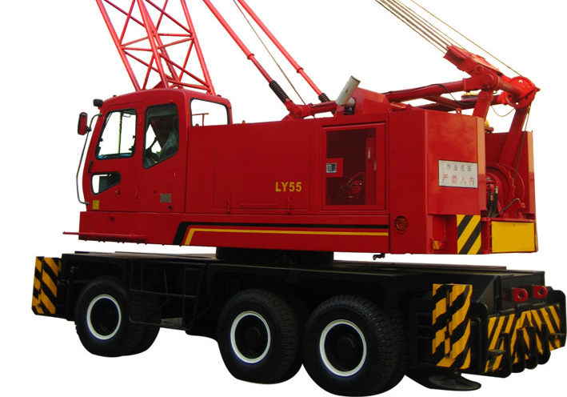
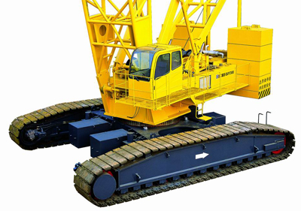
Lattice Boom Cranes in the 21st Century
On wheels or tracks
Small cranes to a constantly increasing upper limit exceeding
1500 tons
Booms made of high-strength steel alloys forming lattice shapes
Powered by combustion engines and hydraulics
http://fortune-group.en.made-in-china.com/
http://www.powerequipco.com/content.asp?page_id=686&uid=&siteid=4

Slide 5
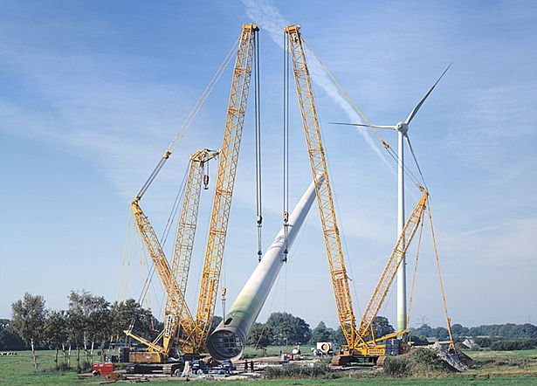
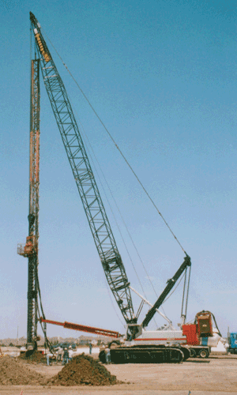
Uses
http://img.directindustry.com/images_di/photo-g/lattice-boom-crawler-crane-117869.jpg
Lifting large loads to otherwise unattainable heights
Moving material and structures around construction projects
Supporting caisson and pile driving equipment
http://www.fhwa.dot.gov/engineering/geotech/pubs/gec8/images/f031.gif

Slide 6
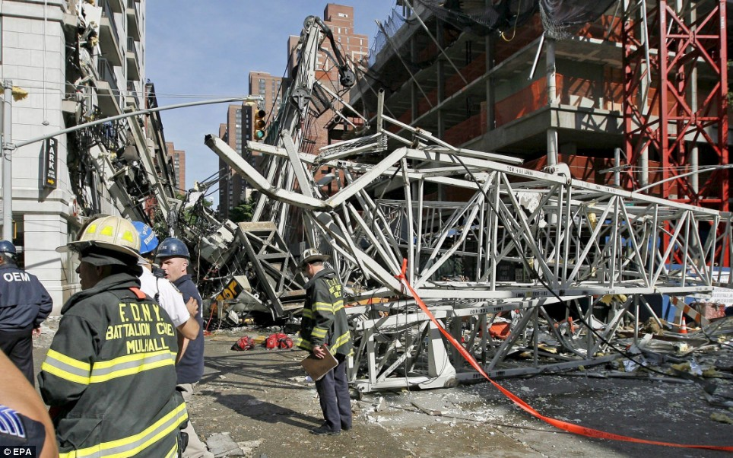
Typical Hazards
Electrical Shock
Overhead Falling Objects
Cable Wear & Failure
Pinch Points
Improper Loading
Boom Failure
http://i.dailymail.co.uk/i/pix/2008/05/30/article-1023080-016E32ED00000578-903_468x292_popup.jpg

Slide 7
Fatalities Involving Lattice Boom Cranes
Based on 32 OSHA investigated fatalities from 1990 thru 2007
*Source: Extracted from OSHA Accident Investigation Data 1990-2007

Slide 8
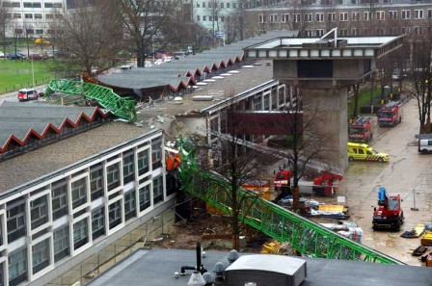
Industry Facts
Each year, more than 20% of eqtipment-related injuries and fatalities involve cranes
In addition, crane accidents are costly and cause hundreds of thousands of dollars in damages each year
http://www.strw.leidenuniv.nl/~ruvisser/nmo/images/storm070118b.jpg
www.osha.gov

Slide 9
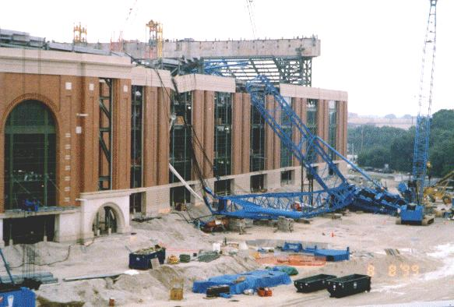
Past Accidents
3 Ironworkers lost their lives in Milwaukee, Wisconsin
Lift included a 450 ton section of roof
Weight of the hoisted load, side loads from wind, and out-of-level ground conditions combined to tip the crane as it rotated with the load
http://www.millerparkscrapbook.org/images/Photos/1999/accident/updkrf0899b.jpg

Slide 10
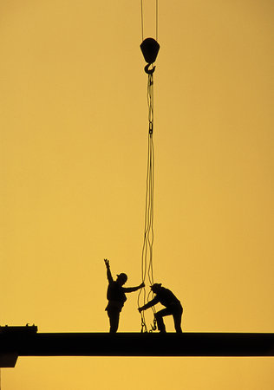
Past Accidents
An Ironworker lost his life
A crane supported a beam to be connected to the outside of a stairway
With the worker sitting on the beam, the crane operator raised the beam 1 foot, causing the worker to slide off
The worker was wearing a safety belt but was not tied off. He fell 45 ft. and suffered fatal injuries
http://s3.images.com/huge.71.357585.JPG
*Source: Extracted from OSHA Accident Investigation Data 1990-2007

Slide 11
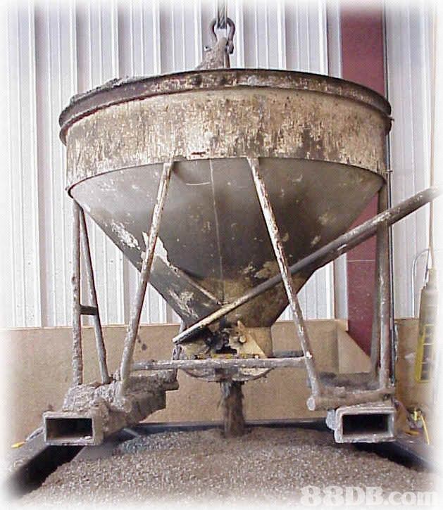
Past Accidents
1 Concrete worker lost his life and 3 more were injured
A crane supported a concrete bucket above a bridge deck
While pouring the concrete, the lattice boom fell without warning
The worker was struck by the falling structure and was pinned between the boom and a concrete screed machine, suffering fatal injuries
http://media1.delhi.88db.com/del/DB88UploadFiles/2009
/04/08/745F64FD-75D0-4DC9-A8F3-6ED6D1B07CA7.jpg
*Source: Extracted from OSHA Accident Investigation Data 1990-2007

Slide 12
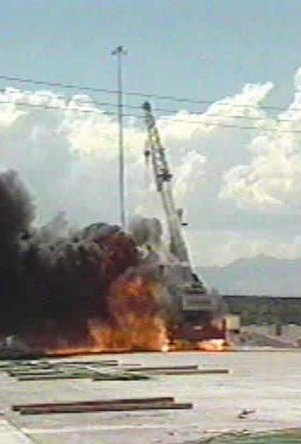
Past Accidents
1 Worker lost his life
A truck-type crane supported a load guided by the worker
The boom contacted a 13 kilovolt overhead power line
The worker was electrocuted instantly
http://www.osha.gov/SLTC/etools/construction/electrical_incidents/cranefire.html
*Source: Extracted from OSHA Accident Investigation Data 1990-2007

Slide 13
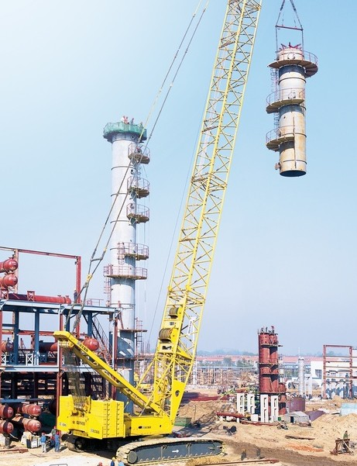
OSHA Regulations Pertaining to Lattice Boom Cranes
Subpart N: 1926.550 Cranes & Derricks
(a) 1. The employer shall comply with the manufacturer’s specifications and limitations applicable to the operation of any and all cranes and derricks. Where manufacturer’s specifications are not available, the limitations assigned to the equipment shall be based on the determinations of a qualified engineer competent in this field and such determinations will be appropriately documented and recorded.
http://image.made-in-china.com/2f0j00KevtiAJMGqbW/QUY450-Crawler-Crane.jpg

Slide 14
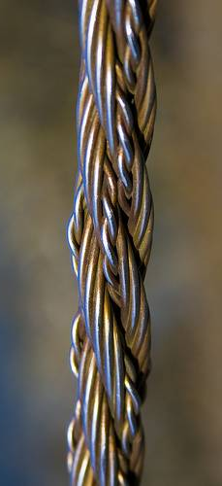
OSHA Regulations Pertaining to Lattice Boom Cranes
(a) 7. Wire rope is to be taken out of service when any of the following conditions exist:
Six randomly distributed broken wires in one lay of the rope
3 broken wires in one strand in one lay of the rope
Wear of 1/3 of the original diameter of the outside individual wires
Evidence of heat damage
Reduction in nominal diameter of 1/64” for 5/16” rope (1/32” for ropes 3/8” to 1/2”)
http://farm3.static.flickr.com/2665/3989052373_d0ef512f37.jpg

Slide 15
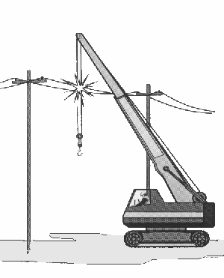
OSHA Regulations Pertaining to Lattice Boom Cranes
(a) 14. (i) Fire extinguishers rated 5BC or higher must be available at all operator stations or cabs of equipment
(a) 15. (i) All parts of the crane and load shall maintain a minimum clearance of 10 feet from power lines rated 50 kV or below
(a) 15. (ii) For every 1 kV over 50 kV, an additional 0.4 inch of clearance shall be maintained

Slide 16
Additional Safe Practices
Careful pre-task planning before every lift to assure the consideration of all potential hazards
Use of personal protection equipment (PPE)
http://www.mark-douglas.co.uk/sitebuildercontent/sitebuilderpictures/ppe.jpg

Slide 17
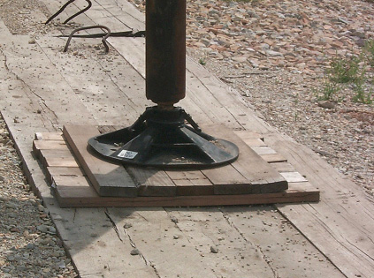
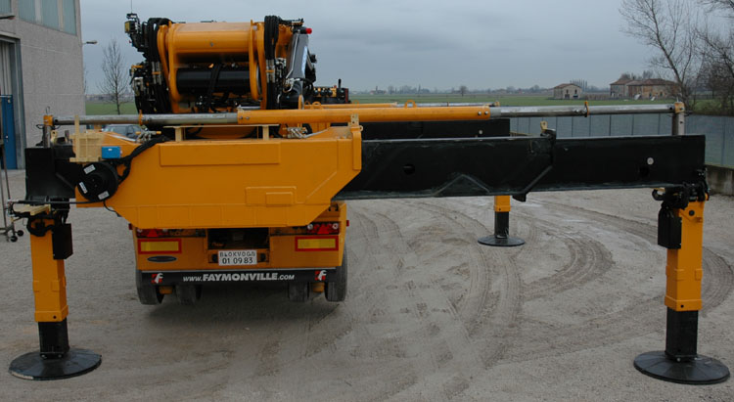
Additional Safe Practices
Assure outriggers are on solid ground sufficient to stabilize the crane and blocking and cribbing are used when necessary
Maintain 3 points of contact between hands and feet while entering the vehicle
http://www.ditzj.de/assets/images/knuckle/dsb3000/dsb3000_06.jpg
http://www.elcosh.org/record/document/96/4.jpg

Slide 18
Additional Safe Practices
Perform inspections on all machinery and equipment prior to each use. Any worn, damaged, or deficient parts must be repaired or replaced before use continues
During the operation of any lattice boom crane, spotters should be used to assure safe distances and that no worker is under any load unnecessarily
http://www.tpub.com/content/administration/14067/css/14067_103.htm

Slide 19
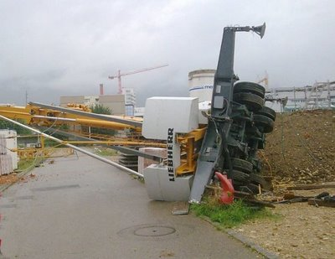
Additional Safe Practices
http://4.bp.blogspot.com/_g6x7iYOa_7o/SmM9j3JjI_I/AAAAAAAABV0/dAtK1F_ePEc/s400/Swiss+Liebherr+MT.jpg
Never exceed safe limits for lifts and move suspended loads slowly
Never operate cranes in inclement weather or excessive winds

Slide 20
Think Safety Work Safely

