Slide 1
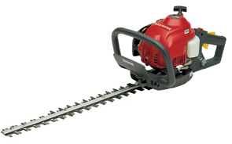
HEDGERS

Slide 2
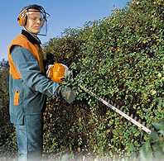
What is a Hedger?
A type of agricultural or garden tool to use to trim hedges, and plants.
Type of hedgers:
Stand alone: this type could be either power driven or manual. The power driven uses gasoline or electricity.
Tractor mounted: this type is more used for pruning of plants and crops.
Source: http:www.buzzle.com/articles/hedge-trimmers-comparison-best-hedge-trimmers.html//

Slide 3
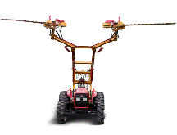
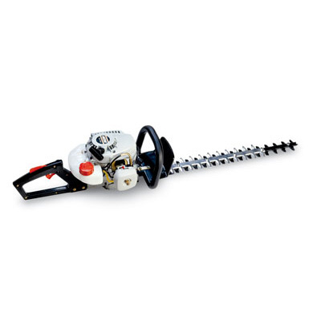
What is a Hedger?
Some types of hedgers:
Gas powered
Tractor mounted
Electric powered
This presentation will not cover tractor mounted hedgers.
Source: http://web.dcp.ufl.edu/hinze/AA-PPT-various/Hedgers-co.ppt

Slide 4
History of Hedger
The origination of the first manual hedger is not recorded , but it is probably evolved from scissors-type cutters.
Since the early 1960s, many patents have been issued on hedgers. Some early patents are:
On Aug. 28, 1962, J. Becker et al disclosed a rotary hedge trimmer utilizing an electric motor to drive a relatively heavy cutting blade.
On Dec. 24, 1968, L. B. Damon disclosed a hedge trimmer involving a heavy blade.
Source: http://www.patentstorm.us/patents/4641431/description.html

Slide 5
Standard Usage of Hedgers
The Safety Procedure includes :
Operators requirements
Transporting
Planning
Site awareness
Preparation fueling
Pre-start daily checks
Operation (5 steps)
On completion
General maintenance

Slide 6
Standard Usage of Hedgers
Step 1:
Attach a piece of string to branches on both ends of the hedge to develop a level line.
Step 2:
Make sure the safety switch is turned off and the extension cord is plugged into the receptacle on the back or bottom (for electric hedgers)
Step 3:
Hold the brace handle and raise the hedgers to the waist height and release the safety switch.

Slide 7
Standard Usage of Hedgers
Step 4:
Trim across the top to level the hedge, starting at the furthest point and working in toward the beginning of the hedge. Move back and forth across the top of the hedge until it is level.
Step 5:
Trim one side of the hedge, beginning at the bottom and moving the hedger upward in gently curved sweeps.

Slide 8
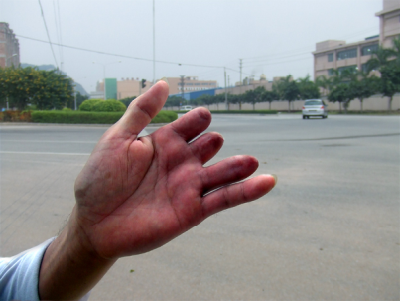
Typical Hazards
The potential hazards varied for different types of hedgers. Generally, blades cause biggest hazards. Typical hazards include:
Finger or hand injury caused by the blades.
Eye injury caused by debris or flying objects picked up or thrown by hedgers.
Fire or toxic fumes caused by unsafe handling of fuel or gas (for gas powered hedgers).
Injuries caused by electricity (for electric hedgers).
Source: web.dcp.ufl.edu/hinze/AA-srPPT-2008/Hedge_Trimmer-16.ppt

Slide 9
Typical Hazards
Warning: Use Caution When Operating Machinery
Incident involving 1 gas powered hedge trimmer =
1 Emergency Response Vehicle
(just happened to be driving by)
14 stitches
$37.00 in first aid supplies
$15.00 co-pay at Urgent Care
1 prescription for Keflex
Source: http://web.dcp.ufl.edu/hinze/AA-PPT-various/Hedgers.ppt

Slide 10
Typical Hazards
Injury Example: when a worker was hedging the front bushes by using electric hedgers, the fingers were cut accidently.
Source: http://dranet.blogspot.com/2007/03/dont-worry-i-still-have-my-finger.html
Injury Example: The U.S. Consumer Product Safety Commission announced a recall of hedge trimmers manufactured by Shindaiwa Inc. because potential hazards existed and required consumers to return the red fuel cap for a replacement cap.
Source: http://www.cpsc.gov/cpscpub/prerel/prhtml04/04017.html

Slide 11
Statistics on Fatalities
There were no OSHA investigations of fatalities caused by hedgers from 1990 thru 2009
Source: Extracted from OSHA Accident Investigation Data 1990-2009

Slide 12
Statistics on Fatalities and Injuries
According to the Royal Society for the Prevention of Accidents, the top ten list of most dangerous garden tools is:
1. Lawnmowers (6,500 accidents in the UK each year)
2. Flowerpots (5,300)
3. Secateurs and pruners (4,400)
4. Spades (3,600)
5. Electric hedge trimmers (3,100)
6. Plant tubs and troughs (2,800)
7. Shears (2,100)
8. Garden forks (2,000)
9. Hoses and sprinklers (1,900)
10. Garden canes and sticks (1,800)
9.3% of the total listed accidents
Source: The figures are based on the Department of Trade and Industry’s Home Accident Surveillance System report 2002, http://www.rospa.com/faqs/detail.aspx?faq=222

Slide 13
OSHA Regulations
No OSHA regulations are specifically related to hedgers.
Some regulations indirectly related to hedger include:
Regulations about PPE requirements (i.e., 1926.102 - Eye and face protection).
Regulations about fuel storage (i.e., 1926.152 – Flammable and Combustible Liquids).
Regulation about Power-handed tools (i.e., 1926.302 - Power-operated hand tools).
Regulations about electricity and electric cords (i.e., 1926 Subpart K - Electrical).

Slide 14
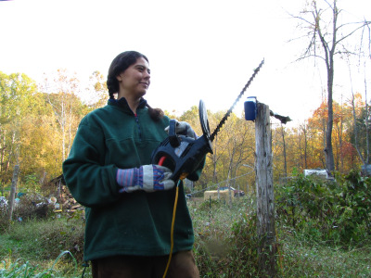
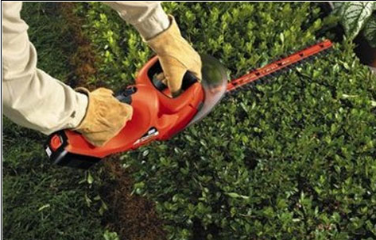
Best Safety Practices
Standard PPE includes but is not limited to:
Safety glasses.
Hearing protection, e.g. ear muffs.
Heavy-duty gloves.
Sturdy shoes with non-slip soles.
Sturdy clothing that allows complete freedom of movement.

Slide 15
Best Safety Practices
The precaution measures should focus on reducing the hazards from blades and the power source (electricity or gas).
Follow the good practices at each stage of the hedger operation.

Slide 16
Best Safety Practices
Before Starting:
Develop Job Hazard Analysis Form to identify the potential hazards.
Conduct job training before doing the task.
Ensure the power tool is properly assembled.
Do not operate the power tool if it is damaged or not properly assembled.

Slide 17
Best Safety Practices
Holding the hedgers:
Always hold the unit firmly with both hands on the handles. Wrap fingers and thumbs around the handles.
Have secure footing and hold the hedger to keep the blades away from the body.

Slide 18
Best Safety Practices
During operation:
check the other side of the hedge before starting work.
Watch the cutting blades at all times.
Take special care in slippery conditions.
Clear away fallen branches, scrubs and cuttings.
keep electric cords clear of moving blades
Do not use electric hedgers in the rain or if standing near water.

Slide 19
Best Safety Practices
During operation:
Do not over-fill the gas tank on the hedge trimmer (gas-powered hedgers)
Wipe away excess fuel that may have spilled while fueling the trimmer (gas-powered hedgers)
Take frequent breaks
Maintain hydration

Slide 20
Best Safety Practices
After Finishing Work
Clean dust and dirt off the machine.
Clean working areas.
Maintenance
Service the machine regularly.
Do not attempt any maintenance work not described in the instruction manual.

Slide 21
Think Safety
Work Safely

