Slide 1
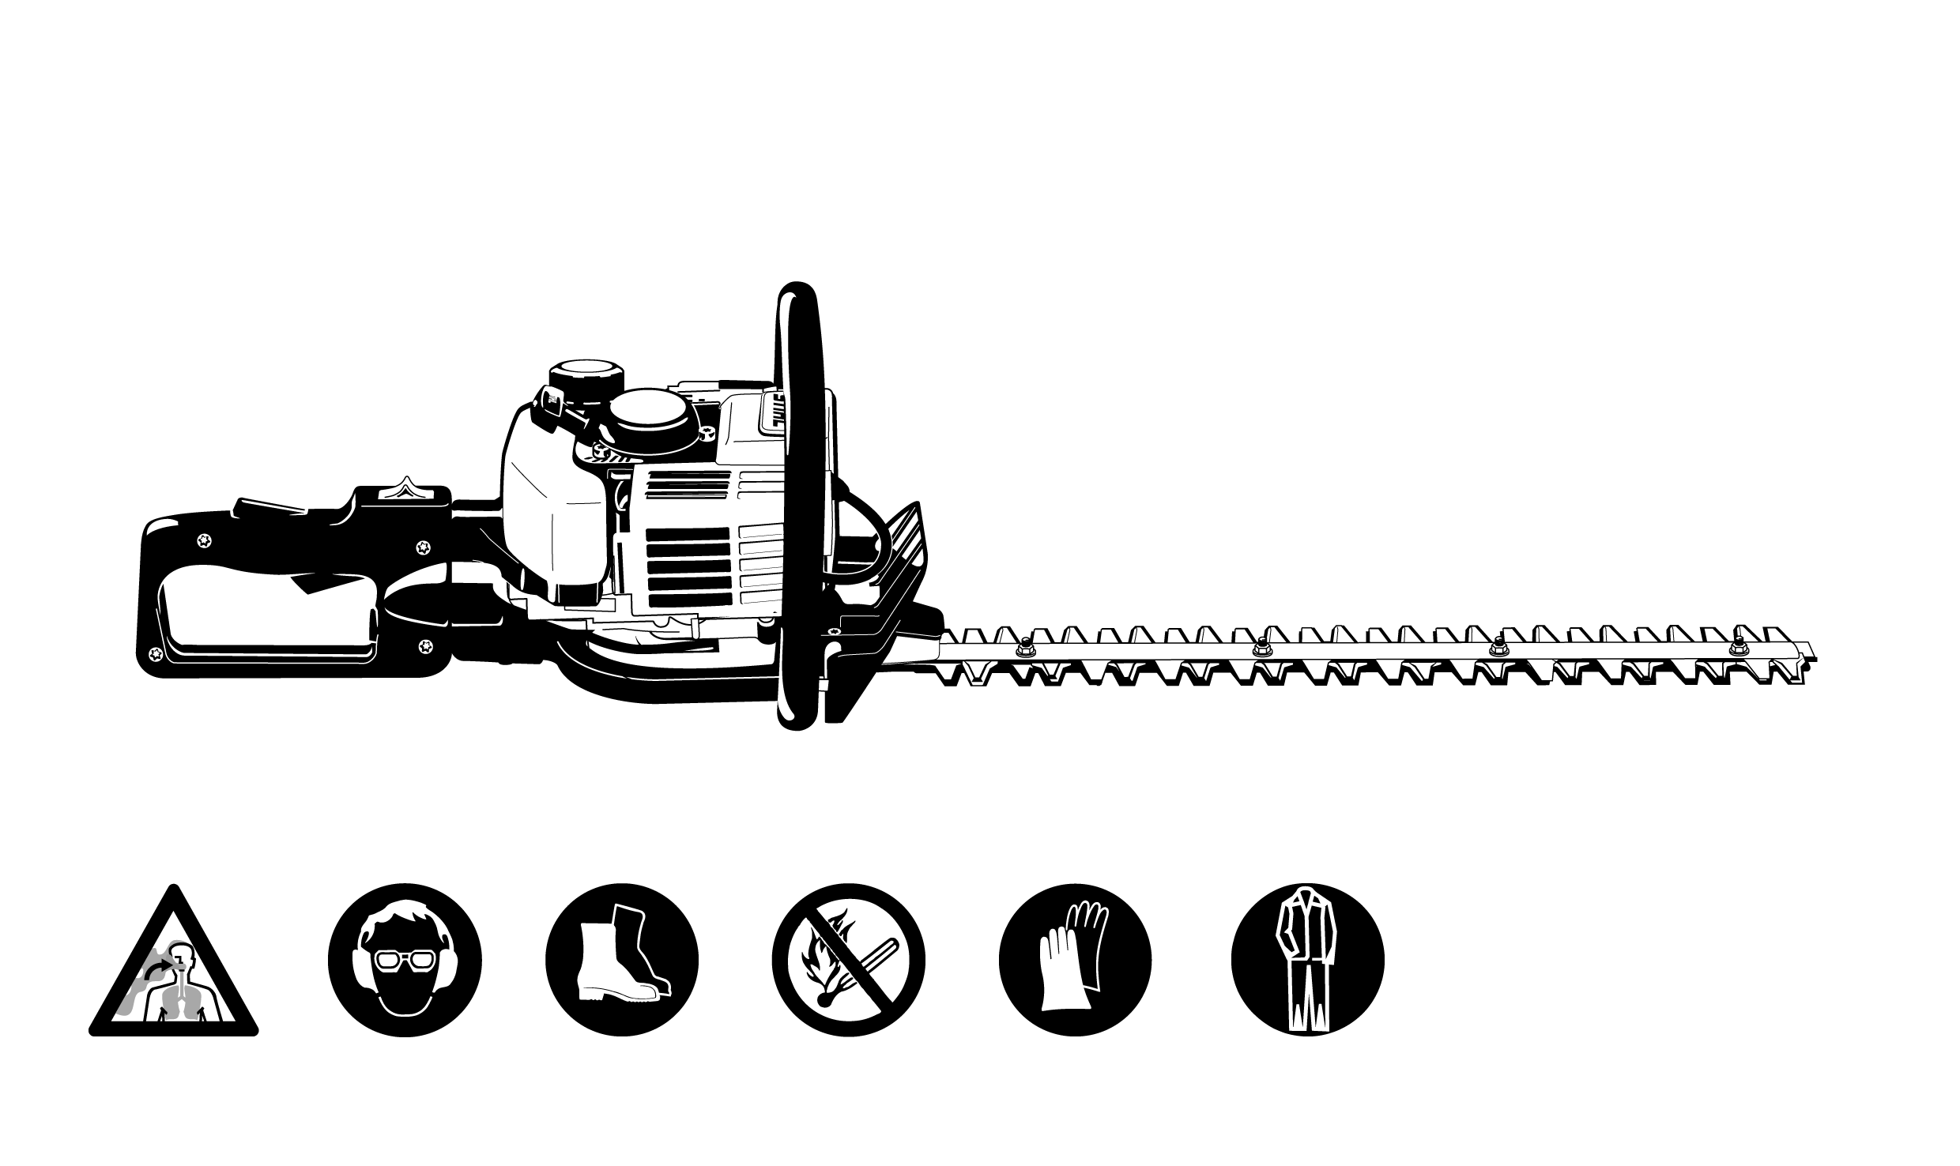
Hedge Trimmer Safety

Slide 2
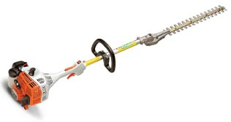
Types of Hedge Trimmers
Used for shrubs and small trees
Generally 30- 40” Blades
Standard Hedge Trimmer
Used for trimming tall shrubs and
small- mid size trees
Generally 20- 30” Blades
42” arm length
Extended Length Hedge Trimmer

Slide 3
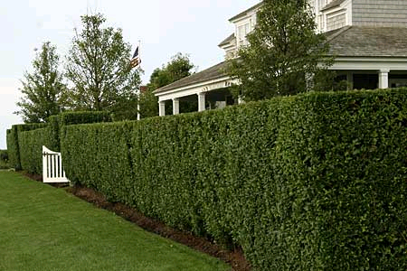
History of Hedge Trimmers
In the past, garden shrubs and hedges were cut with manually-operated hand pruners and clippers. Gas/electric hedge trimmers were created to dramatically speed up the process of hedge trimming.

Slide 4
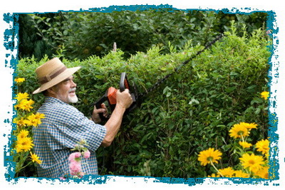
Standard Hedge Trimmers Safety
Hedge Trimmers have a safety button that must be depressed
before the trigger is “live”
This helps prevent misfires
and careless injuries
Potential hazard- The distance between blade prongs is about ¾ -1” wide
This distance is large enough to amputate a finger or lacerate a body part

Slide 5
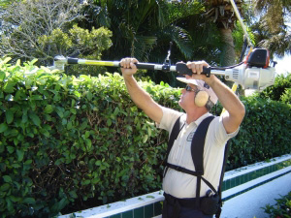
Extended-Length Hedge Trimmer
Pro- Longer reach allows
user to prune hard to
reach places
Pro- Head pivots at 90
degree angle for easier
straight-edge trimming
Pro- Reduces the need for step-ladders;
creating a safer work environment
Con- Can be dangerous if an inexperienced worker cannot safely manage the “top heavy” weight of the blade

Slide 6
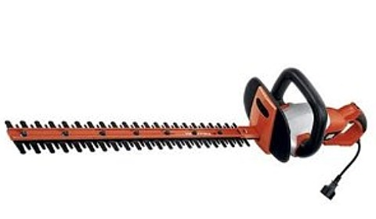
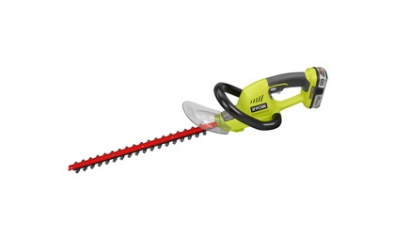
Types of Standard Hedge Trimmers
Electric Hedge Trimmer- Lighter than gasoline-operated hedge trimmers, but users risk electrocution.
Battery-powered Hedge Trimmer- Lighter than gas powered but limited time use between battery recharges. Lithium batteries have helped to improve battery life but this type of hedge trimmer is still not practical for professional use.

Slide 7
Types of Standard Hedge Trimmers
Heavy-duty hedge trimmer: Chain spins at
maximum RPM to produce high torque, which
creates a hazard for users. While using a hedge
trimmer at his professional lawn business, a
business owner accidently hit his leg with the
trimmer, and required12 stitches to close the wound.

Slide 8
Hedge Trimmers in Construction
Used in landscaping
Landscaping does not occur until after construction is nearing completion, so hedge trimmers are usually not used until the post-construction process

Slide 9
Safety Concerns
Like with any automatic lawn tool, precautions must be taken when handling this tool. While its main purpose is to trim flora, if misused it can cause serious harm to the user.

Slide 10
Hazards Associated with Gas Powered Trimmers
Gas-powered trimmers require the use of a special gas/oil mix. If filled with standard gas, the engine may burn up.
The exhaust port on the back of the hedge trimmer gets extremely hot after prolonged use. If accidently touched by the operator, it can cause severe burns.

Slide 11
Hazards Associated with Gas-Powered Trimmers
The chain movement inside the engine causes heavy vibrations which can loosen the gas/oil cap.
If this cap comes off, the gas/oil mix can spill, creating a fire hazard in the work area

Slide 12
Hazards Associated with Electric-powered Trimmers
The number one danger when working with electric-powered trimmers is electrocution, such as when the extension cord is accidently cut

Slide 13
Hazards Associated with Electric-powered Trimmers
Always route the extension cord where it will not be accidently cut or where it cannot become a tripping hazard
Always use ground fault circuit interrupters (GFCIs) to protect workers from electrocution

Slide 14
Hazards Associated with Electric-powered Trimmers
Never operate equipment in wet conditions
If one MUST work in a wet area (recently watered) make sure to keep the contact (male/female) portions of the extension cord dry

Slide 15
Carbon Monoxide Poisoning
Hedge trimmers release carbon monoxide, much like any other gas-powered lawn equipment. The amount released generally is not very harmful.
The real danger arises if the operator uses the trimmer indoors, where the carbon monoxide levels can raise to dangerously high levels. Its effects on the human body are almost unnoticeable until the user becomes unconscious, making it extremely dangerous.

Slide 16
Source: Extracted from OSHA Accident Investigation Data 1990-2009
There were 0 construction worker fatalities that were investigated by OSHA from 1990 to 2009

Slide 17
There are no OSHA regulations that specifically mention or address the safe use of hedge trimmers

Slide 18
Safe Work Practices Personal Protection Equipment
When hedge trimming, the following equipment should always be worn
Safety Glasses (Clear
or UV protection)
Work Gloves w/ Grip
Hearing protection

Slide 19
Personal Protective Equipment
Wear long pants (preferably jeans)
to protect against airborne debris and
to help protect against hedge trimmer
blades
Wear closed toe shoes
(preferably boots)
Wear a respirator mask
to prevent dust inhalation,
when applicable

Slide 20
Safe Work Practices
When using the hedge trimmers, it is the operator’s duty to make sure bystanders (including pets) are not within the range of the hedge trimmers.

Slide 21
Safe Work Practices
Precautions must also be taken when filling gas-powered trimmers with gas. The user should only fill the tank about ¾ full to avoid spilling gas around the equipment.

Slide 22
Equipment Inspections
The hedge trimmers should be inspected periodically to check for loose parts and screws
If there are any signs of rattling noises inside the engine, the equipment should be taken to a certified repair specialist

Slide 23
Think Safety
Work Safely

