Slide 1
Grinders

Slide 2
History
Fixed grinders have been around for centuries. Originally used for sharpening cutting tools such as knives, swords, and axes.
Angle grinders evolved much later and have attachments making it a more versatile tool.

Slide 3
Types
Bench Grinder
Angle Grinder

Slide 4
Bench Grinder
Used for finer more intricate work.
Sharpening chisels and knives.
Polishing metal.
Different wheels can be interchanged for different results.

Slide 5
Angle Grinder
Can be used for grinding, cutting, sanding, polishing, and buffing.
More versatile depending on the disk. It can cut metal, plastics, and concrete.
Commonly used in construction and metal working, as well as emergency rescue work.
The size and type of wheel defines the type of work that can be done.

Slide 6
Work Hazards
Typical hazards include
Sparks and excess material projectiles that result from normal use
Bad discs shredding and flying off at extremely high speeds
Discs binding and causing the tool to jerk violently, which may result in broken bones and/or dislocations
"Angle Grinder." Wikipedia. 06/2009. Web. 1 Dec 2009. <http://en.wikipedia.org/wiki/Angle_grinder>.

Slide 7
Work Hazards (Cont)
Injury sustained by shredded abrasive disc
"Grinder to Face." New Institute of Trauma and Injury Management. Web. 1 Dec. 2009. <http://images.google.com/imgres?imgurl=http://www.itim.nsw.gov.au/images/angle_grinde_to_face21.jpg&imgrefurl=http://www.itim.nsw.gov.au/index.cfm%3Fobjectid%3D2A01230E-1321-1C29-701DD35B176E139B&usg=__zimnE6u7mY4xoO4ffHrpPmaD6ho=&h=480&w=640&sz=64&hl=en&start=4&um=1&itbs=1&tbnid=GGNa3W5CkcC8PM:&tbnh=103&tbnw=137&prev=/images%3Fq%3Dangle%2Bgrinder%2Binjuries%26hl%3Den%26sa%3DN%26um%3D1>.

Slide 8
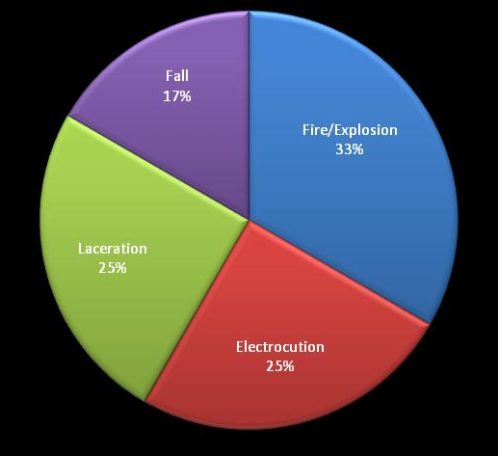
Fatality Statistics
There were 11 OSHA-Investigated fatalities involving grinders from 1990 thru 2009.
The causes are displayed in the following pie chart:
Source: Extracted from OSHA Accident Investigation Data 1990 to 2009

Slide 9
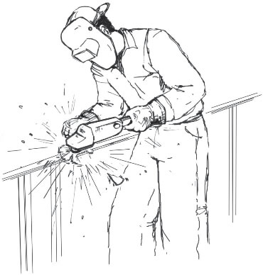
Fatality Example
A worker was using a 7” angle grinder when it caught on some material and kicked back cutting the man’s thigh. The man bled to death before the paramedics could help him.

Slide 10
Fatality Example
A worker was grinding in the tight space between both ends at the bottom of 10 in. pipes. When he retracted the grinder approximately 3 to 4 in. away from the tight space, a loud noise was heard and the grinding wheel flew off the grinder. The wheel struck the pipe and ricocheted upwards through the tarp cover. A fragment struck the worker on the forehead, killing him.

Slide 11
OSHA Regulations
Resources/OSHA/Book-Examhttp://www.mancomm.com/Departments/ples.aspx
1910.243 (a) (2) (ii)
All hand-held powered drills, tappers, fastener drivers, horizontal, vertical, and angle grinders with wheels greater than 2 inches in diameter, disc sanders with discs greater than 2 inches in diameter, belt sanders, reciprocating saws, saber, scroll, and jig saws with blade shanks greater than a nominal one-fourth inch, and other similarly operating powered tools shall be equipped with a constant pressure switch or control, and may have a lock-on control provided that turnoff can be accomplished by a single motion of the same finger or fingers that turn it on.

Slide 12
OSHA Regulations
Subpart I – Tools – Hand and Power
CFR 1926.303: Abrasive Wheels and Tools
B. Guarding
1. Grinding machines shall be equipped with safety
guards.
C. Use of Abrasive Wheels
4. Portable abrasive wheels used for internal grinding shall be provided with safety flanges unless:
The wheels are 2 inches or less in diameter.
Wheels are entirely within the work being ground while in use.

Slide 13
OSHA Regulations
Subpart I – Tools – Hand and Power
CFR 1926.303: Abrasive Wheels and Tools
C. Use of Abrasive Wheels
7. All abrasive wheels shall be closely inspected and ring-tested to ensure that they are free from cracks or defects.
8.Grinding wheels shall fit freely on the spindle and shall not be forced on. The spindle nut shall be tightened only enough to hold the wheel in place.
9. All employees using abrasive wheels shall be protected by eye protection equipment.

Slide 14
Best Practices
Proper P.P.E. to wear when operating a grinder includes:
Hard Hat
Face Shield
Gloves
Flame-resistant Clothing
Long-sleeved Shirt
Jeans
Boots
Hearing Protection
Knee Pads (if kneeling)

Slide 15
Best Practices
Use on a solid surface.
Make sure there is nothing flammable near by.
Keep hands and clothing away from moving parts.
Keep both hands on tool when in use.
Never cut near wiring.
Never cut unsecured material.
Never take off the manufacturer's safety devices (disk guards).
Never cut flammable material.
Keep work area clean.

Slide 16
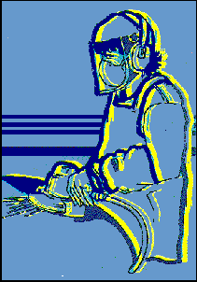
Best Practices
Never use defective equipment
Never use a tool with a broken chord
Never use tool alone
Only use the tool for tasks it was designed to do.

Slide 17
Think Safety
Work Safely

