Slide 1
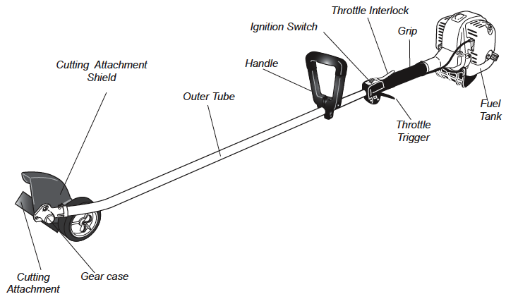
PORTABLE EDGERS
SWISHER OWNER’S/OPERATOR’S MANUAL for E4-E3000 LAWN EDGER

Slide 2
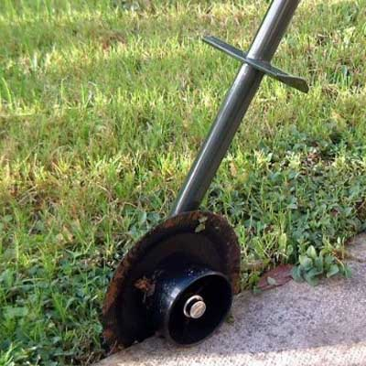
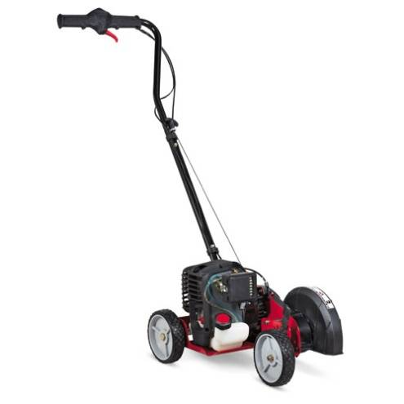
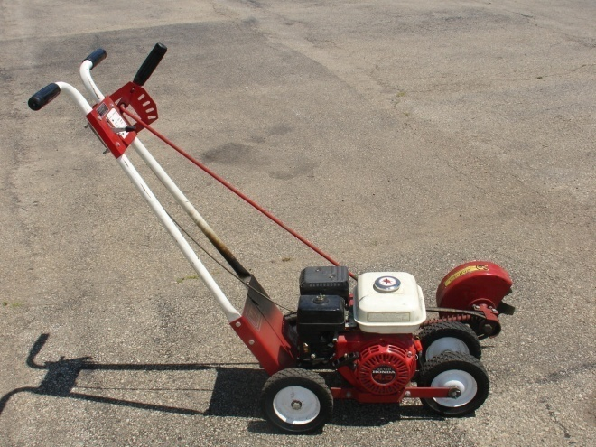
EDGER DESCRIPTION
An edger is a lawn-care tool used to trim grass or weeds cleanly from the edge of a walkway.
Created by King o’ Lawn in 1940.

Slide 3
PORTABLE EDGER USE
Edgers may be manual or automated
Manual: shown in figure 1, consists of a circular or hemispherical blade attached to an elongated handle.
Automated: shown if figures 2, usually employs a rotating wheel blade powered by a small gasoline motor.
Figure 1
Figure 2

Slide 4
TYPICAL HAZZARDS
Product Safety Commission (CPSC) reports that more than 230,000 people per year are treated for injuries from lawn and garden tools.
These tools include lawn mowers, trimmers, edgers and other power equipment.
Injuries include:
Minor to severe burns from a hot engine
Eye injuries from flying debris
Cuts acquired during maintenance
Loss of fingers and toes from spinning blade
OSHA - subsection “Landscape and Horticultural Services”

Slide 5
OSHA
No Fatalities have been recorded by OSHA for Portable Edgers.
No OSHA regulations specific to
Portable Edger.
OSHA – FATALITIES 2007 - 2009

Slide 6
BEST PRACTICES - PPE:
Utilize appropriate footwear.
Non-skid boots or shoes
No open toed shoes or sandals
NEVER operate equipment barefoot!
SWISHER OWNER’S/OPERATOR’S MANUAL for E4-E3000 LAWN EDGER

Slide 7
BEST PRACTICES - PPE:
Hearing and Eye Protection
Ear plugs or ear muffs safeguards from long exposure to motor sounds
Goggles or safety glasses will ensure flying debris does not damage the eyes
SWISHER OWNER’S/OPERATOR’S MANUAL for E4-E3000 LAWN EDGER

Slide 8
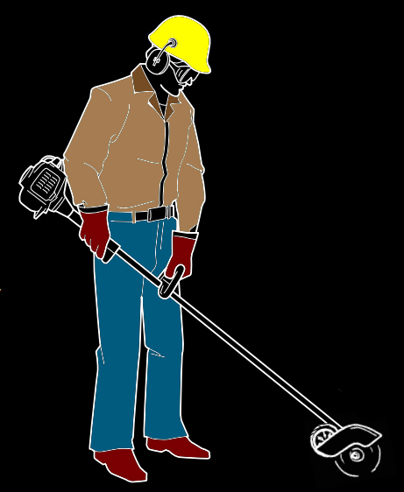
BEST PRACTICES - PPE:
Clothing and Gloves
Wear close-fitting clothing to protect arms and legs from debris
Gloves should be worn during operation and maintenance
SWISHER OWNER’S/OPERATOR’S MANUAL for E4-E3000 LAWN EDGER

Slide 9
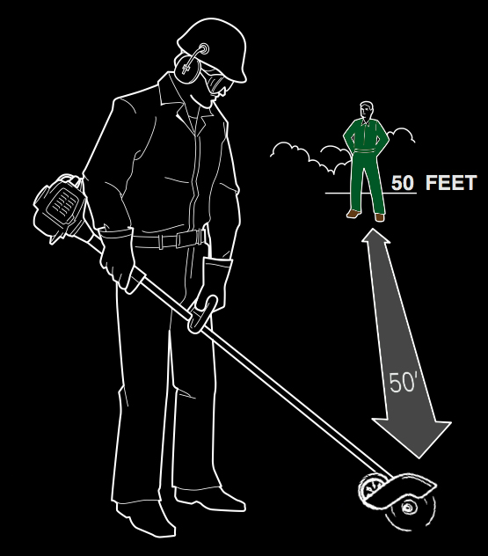
GENERAL BEST PRACTICES
Area and Electricity
Make sure nobody is within 50’ while edger is being used
Use caution when cutting near electrical cords to avoid making contact with the spinning blade
SWISHER OWNER’S/OPERATOR’S MANUAL for E4-E3000 LAWN EDGER

