Slide 1
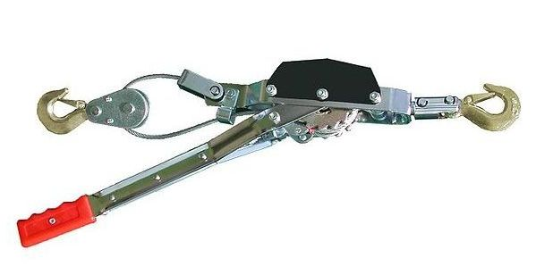
Come-a-longs

Slide 2
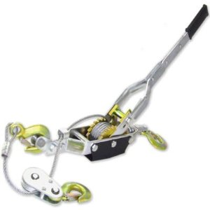
Definition
Small portable winch usually consisting of a cable attached to a hand-operated ratchet
http://www.merriam-webster.com/dictionary/come+along?show=1&t=1302724539

Slide 3
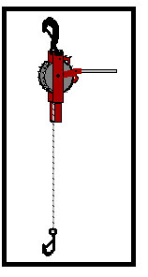
Definition
May also be referred to as:
Ratchet Hoist
Red-Devil
Guy Puller
Pull Jacks
http://www.msha.gov/Accident_Prevention/Tips/ratchethoist.htm

Slide 4
History
Developed by Abraham Maasdam
Developed in 1919
Commercialized by Felber Maasdam
Commercialized in 1946
http://en.wikipedia.org/wiki/Hoist_(device)

Slide 5
Applications
Come-a-longs can be used for:
Fence stretching
Moving machinery
Moving pipe or plates into position for welding or bolting
Stretching cable (power lines, telephone lines,etc)
http://www.empirepac.com/downloads/toolboxTalks/Come%20Alongs%20and%20Hoists2.pdf

Slide 6
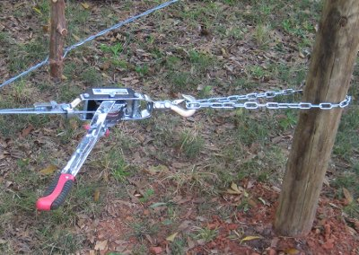
Applications
Figure: Section of fence being stretched into place using a come-a-long
http://my5acredream.blogspot.com/2010/10/progress-on-fence.html

Slide 7
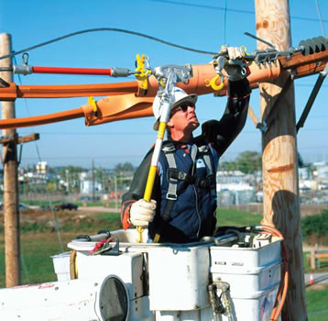
Injuries
Most common injuries occur when the hook slips or something in the “system” fails.
http://www.msha.gov/Accident_Prevention/Tips/ratchethoist.htm
Figure: Worker securing power line into position

Slide 8
Injuries
Some injuries that can occur include:
Deep gashes
Lost teeth
Concussions
Fracturing of the hands, arms, legs and ribs
Electrocution
Falls
http://www.msha.gov/Accident_Prevention/Tips/ratchethoist.htm

Slide 9
Accidents
Accidents occur:
When the hook slips
When something in the ‘system' fails
Failures often cause the chain, rope, or wire to ‘whip’ back with considerable force
http://www.msha.gov/Accident_Prevention/Tips/ratchethoist.htm

Slide 10
Stats (not specific to construction)
From 1992 to 2004, 136 workers died in the United States from overhead hoist operations.
Nine fatalities occurred in 2004, with an additional three deaths in 2003.
Come-a-longs account for about 1 in 10 hand tool accidents.
http://www.anapolschwartz.com/practices/construction-accidents/dangerous-hoists.asp
http://www.msha.gov/Accident_Prevention/Tips/ratchethoist.htm

Slide 11
Construction Fatalities
In the time period of 1990 thru 2009 there were 16 fatalities investigated by OSHA.
http://www.krallconst.com/Electrical.html
Source: Extracted from OSHA Accident Investigation Data

Slide 12
Come-a-Long Fatality Case
Workers were attaching a cable to a utility pole using a come-a-long when the energized conductor fell from its base and electrocuted the worker in the bucket truck
Source: Extracted from OSHA Accident Investigation Data 1990-2009

Slide 13
Come-a-Long Fatality Case
A worker had a come-a-long attached to a step bolt above an antenna mount. When the step bolt broke, the worker fell 170 feet to the ground.
Source: Extracted from OSHA Accident Investigation Data

Slide 14
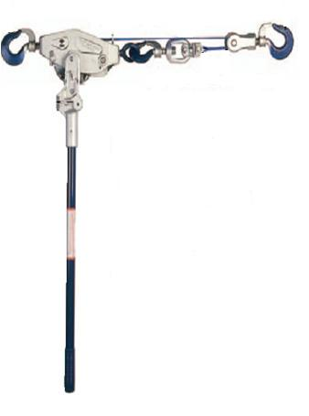
OSHA Provision
1926 Appendix A, Subpart L
(2)(r)(3) When using Catenary Scaffolds, the maximum capacity of come-along shall be 2,000 lbs.

Slide 15
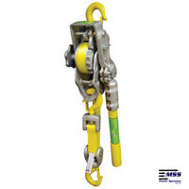
PPE for Safety
Safety glasses
Gloves
Hard hat
Steel-toed boots

Slide 16
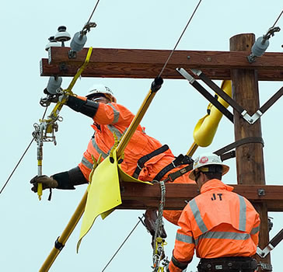
Best Practices
In addition to OSHA regulations, there are some ‘best practices’ to prevent injury.
Figure: Worker securing power line into position

Slide 17
Best Practices
Make sure that latches work properly and are in good condition.
Check the cable, chain or strap for any type of damage (fraying or splitting).
Tag defective items and remove them from service.
http://www.msha.gov/Accident_Prevention/Tips/ratchethoist.htm

Slide 18
Best Practices
Be certain that all parts of the ‘system' can take the load. Do not forget to check anchor points.
Use appropriate anchors or slings.
Do not use a CHEATER BAR (an extended handle) to exert more force on the come-a-long than it is designed for.
http://www.msha.gov/Accident_Prevention/Tips/ratchethoist.htm

Slide 19
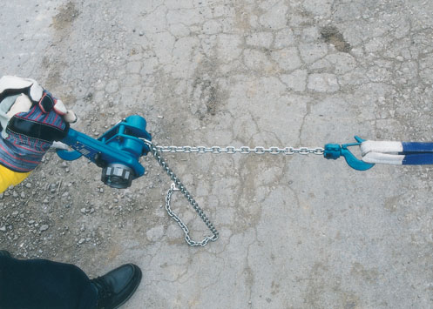
Best Practices
Keep safe load limit posted on the hoist.
Keep wire ropes and chains lubricated.
http://www.anapolschwartz.com/practices/construction-accidents/dangerous-hoists.asp

Slide 20
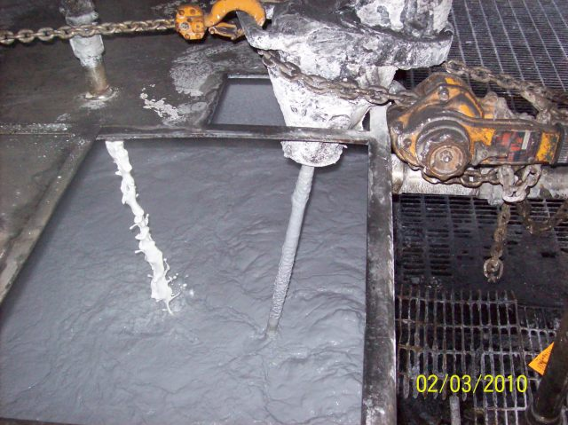
Best Practices
Do not leave suspended loads unattended.
Do not use as blocking for raised equipment.
Figure: Come-a-long being used to hold up and stabilize a mixing motor
http://www.anapolschwartz.com/practices/construction-accidents/dangerous-hoists.asp

Slide 21
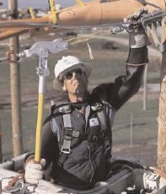
Best Practices
Do not use for lifting people.
Do not pass a load over workers.
Do not insert the point of the hook in a link.
Do not exceed the rated load capacity.
Do not straddle come-along
Keep the body out of the line of fire
Figure: Employee securing electrical cable using come-a-long
http://www.anapolschwartz.com/practices/construction-accidents/dangerous-hoists.asp

Slide 22
Think Safety Work Safely

