Slide 1
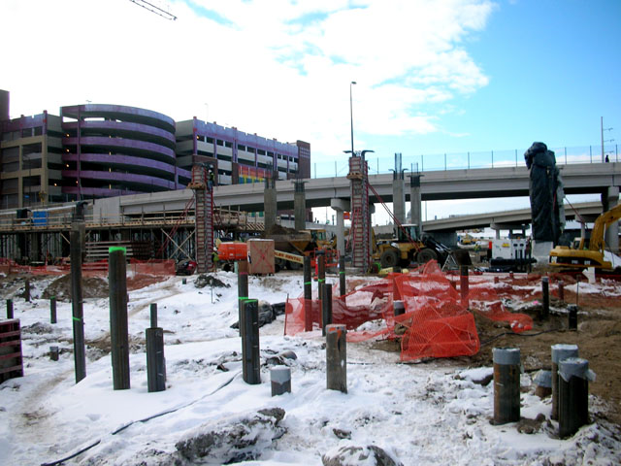
COLD WEATHER
Construction of Twins Baseball Stadium – Minneapolis, MN

Slide 2
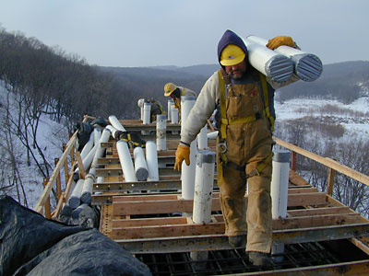
Cold Weather: Definition
Varies by region of the country
“Cold” temperatures < 40º F
“Cool” temperatures (40 - 60º F)
Temperature information inferred from www.cdc.gov
Taken from www.go-explore-trans.org

Slide 3
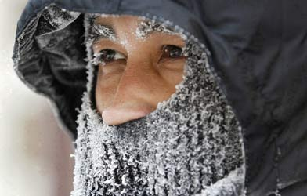
Common Cold Weather Elements
Rain, freezing rain, snow, sleet, ice, and frost
Damp or wet clothing makes the body feel colder
Wind
“wind chill” causes the air to feel colder than it really is
Taken from www.cbc.ca

Slide 4
Wind Chill Effect
mph | temp | 20 | 25 | 30 | 35 | 40
60 |  | -4 | 3 | 10 | 17 | 25
55 |  | -3 | 4 | 11 | 18 | 25
50 |  | -3 | 4 | 12 | 19 | 26
45 |  | -2 | 5 | 12 | 19 | 26
40 |  | -1 | 6 | 13 | 20 | 27
35 |  | 0 | 7 | 14 | 21 | 28
30 |  | 1 | 8 | 15 | 22 | 28
25 |  | 3 | 9 | 16 | 23 | 29
20 |  | 4 | 11 | 17 | 24 | 30
15 |  | 6 | 13 | 19 | 25 | 32
10 |  | 9 | 15 | 21 | 27 | 34
5 |  | 13 | 19 | 25 | 31 | 36
For Example:
A temperature of 30 degrees Fahrenheit with a 40 mile per hour wind would feel like 13 degrees Fahrenheit.

Slide 5
Hazards
Loss of Grip Strength
A study by Horvath and Freedman found that “grip strength decreased by one-fourth even though the cold exposure was of relatively short duration”.
Could lead to dropping of equipment such has hammers or torches
Horvath, S.M., and Freedman, A. The Influence of Cold upon the Efficiency of Man. Journal of Aviation Medicine, 18, 158-164, 1947.
Taken from journalistopia.com

Slide 6
Hazards
Core Temp (°F) | Body’s Response
99.6 | Normal body temperature
96.8 | Metabolic rate increases
95 | Pronounced shivering
91.4 | Severe hypothermia
86 | Consciousness loss begins
75.2 | Pulmonary edema
68 | Cardiac Standstill
Hypothermia
Lowered core body temperature
Drop in blood pressure
Mental confusion
Death (if left untreated)

Slide 7
Hazards
Frost
Frost on roofs, scaffolding, ladders, etc, may present a danger of slipping and falling
Leading cause of deaths in the construction industry due to cold weather
Frostbite
Occurs when the body constricts blood flow to extremities in order to preserve core body temperature
Prolonged exposure will lead to permanent cell damage

Slide 8
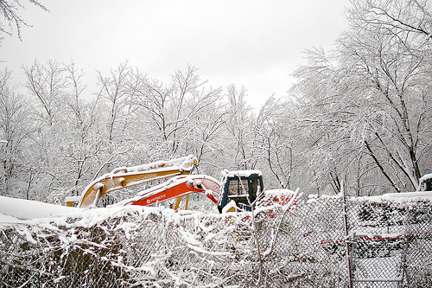
Hazards
Unpredictable Conditions
Cold weather changes many of the conditions on the construction site such as soil
Equipment may become frozen to the ground
Trench conditions may become unpredictable
Excavated soil can freeze, becoming dangerous if loose
Taken from flickr.com/photos/ alohadave/2194113460/

Slide 9
Fatalities
28 deaths attributed to cold weather conditions were investigated by OSHA from 1990 thru 2009
Most death cases are attributed to slips and falls due to frost, ice, and snow
Frozen soil conditions are also causal factors
Source: Extracted from OSHA Accident Investigation Data 1990-2009

Slide 10
Fatality Example
A worker was staging bundles of shingles on the second story roof of a newly-constructed house. The worker was on the east side of the house near a valley when he slipped on frost or ice on the roof and fell 21 feet to the ground. He was transported to the hospital where he died the next day.
Source: Extracted from OSHA Accident Investigation Data 1990-2009

Slide 11
OSHA Regulations
1926.451(a)(17) addresses snow buildup
In a sample safety plan, OSHA regulations state:
“When wet weather (rain, snow, or sleet) are present, roof sheathing operations shall be suspended unless safe footing can be assured for those workers installing sheathing”
Source: OSHA Regulations 1926

Slide 12
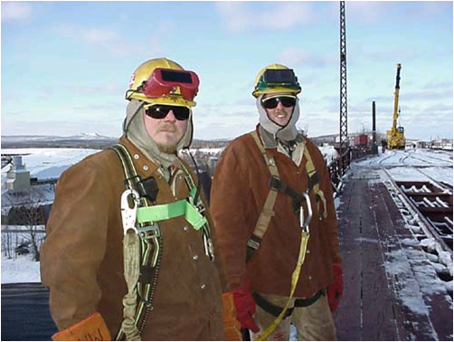
Best Practices
PPE
Care must be taken to properly cover all exposed skin with appropriate clothing made for the cold weather environment
Cold Weather clothing should:
Provide high insulation
Allow Moisture to escape
Waterproof
Shed snow
Allow air flow
Not restrict movement
Have minimum weight and bulk

Slide 13
Best Practices
Provide an on-site break area that is heated and dry
Require warm-up breaks based on
length of shift and experienced
temperature
Reduced visibility
Use brightly colored signs
Double check for workers in area
Cease current construction work
if visibility is significantly
hampered by weather

Slide 14
Best Practices
Environmental Awareness
Checks should be made each morning for potential hazards that may have formed due to freezing overnight temperatures
Strictly enforce pre-task planning and its documentation
Training
Train workers in avoiding consequences of cold weather exposure
Train workers in recognizing symptoms of hypothermia, frostbite, cold stress, and other cold-related illnesses.

Slide 15
Best Practices
Use the buddy system so workers are never working alone in isolated areas
Food and Drink
Be sure employees are staying well-hydrated
Avoid caffeine, alcohol, and other drugs
Consume high-calorie foods and sports drinks

Slide 16
Think Safety
Work Safely

