Slide 1
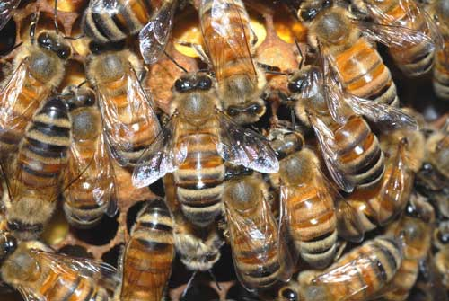
Bees
http://hutnyk.files.wordpress.com/2009/06/bees.jpg
<number>

Slide 2
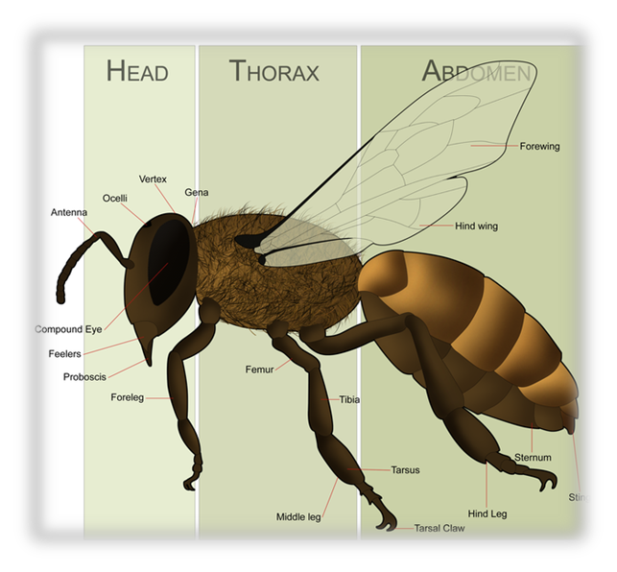
(http://en.wikipedia.org/wiki/Bee)
Background information on bees
Bees are flying insects closely related to wasps and ants, and are known for their role in pollination and for producing honey and beeswax.
Bees are a monophyletic lineage within the superfamily Apoidea, presently classified by the unranked taxon name Anthophila.
There are nearly 20,000 known species of bees in seven to nine recognized families, though many are undescribed and the actual number is probably higher.
They are found on every continent except Antarctica, in every habitat on the planet that contains insect-pollinated flowering plants.
<number>

Slide 3
Background information on bees
Scientific Classification
Kingdom: Animalia Phylum: Arthropoda Class: Insecta Order: Hymenoptera Suborder: Apocrita Superfamily: Apoidea (unranked): Anthophila
(http://en.wikipedia.org/wiki/Bee)
<number>

Slide 4
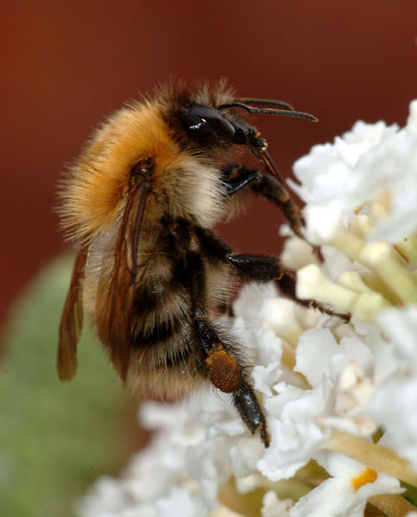
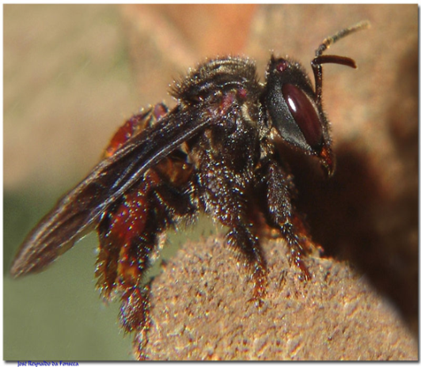
Types of Bees
Bumble Bee
Stingless Bee
Honey Bee
Africanized Bee ( killer Bee )
Bumble Bee
Stingless Bee
<number>

Slide 5
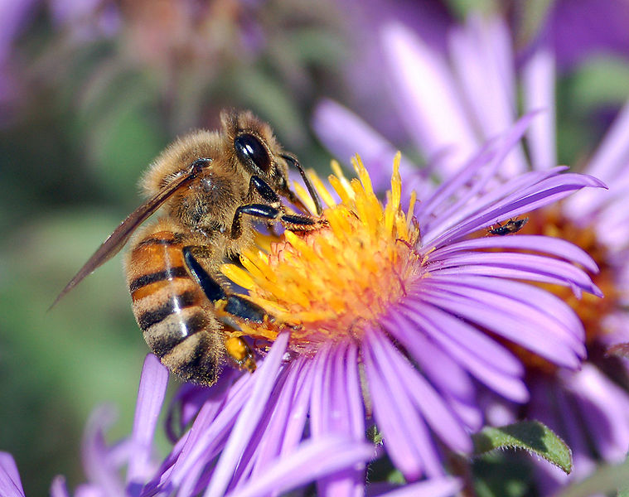
Types of Bees: Western Honey Bee
The common bee is the Western Honey Bee.
Agitated by provocation and does not persistently fly more than a few feet when stinging.
Sends few drones for defense.
Distinguished by the production and storage of honey and the construction of perennial, colonial nests out of wax.
Western Honey Bee
<number>

Slide 6
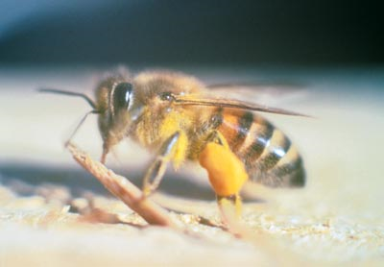
Types of Bees: Africanized Bee
Similar to the common bee (western honey bee) but are more likely to attack a perceived threat and when they do so, attack relentlessly in larger numbers.
This aggressively protective behavior has been termed by scientists as hyper-defensive behavior.
This defensiveness has earned them the nickname "killer bees," the aptness of which is debated.
Africanized Bee
(Killer Bee)
<number>

Slide 7
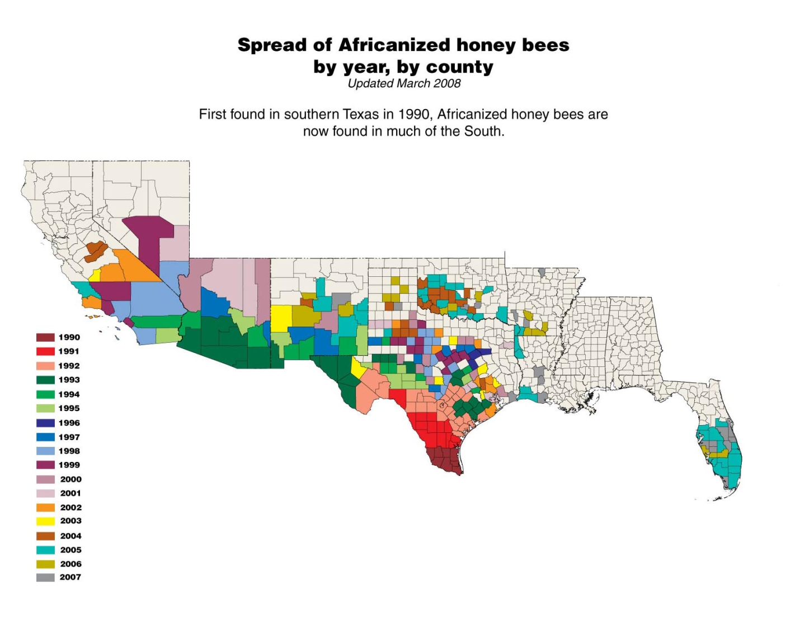
Types of Bees: Africanized Bee
The spread of Africanized Bees (1990 – 2007)
Image courtesy of Agricultural Research Services
www.ars.usda.gov.ahbmap
<number>

Slide 8
“Bee-havior”
A honey bee that is away from the hive is usually foraging for nectar or pollen.
Pollen is a fine to coarse powder containing the microgametophytes of seed plants, which produce the male gametes . Pollen grains have a hard coat that protects the sperm cells during the process of their movement between the stamens to the pistil of flowering plants
Bees will rarely sting, except when stepped on or roughly handled. Honey bees will actively seek out and sting when they perceive the beehive is threatened.
A beehive is an enclosed structure in which some honey bee species live and raise their young. Natural beehives are naturally-occurring structures occupied by honey bee colonies, while domesticated honey bees live in man-made beehives often in an apiary.
(http://www.absoluteastronomy.com/topics/Bee_sting)
<number>

Slide 9
“Bee-havior”
A Worker Bee is a female eusocial bee that lacks the full reproductive capacity of the colony's queen bee; under most circumstances, this is correlated to an increase in certain non-reproductive activities relative to a queen.
(http://www.absoluteastronomy.com/topics/Bee_sting)
<number>

Slide 10
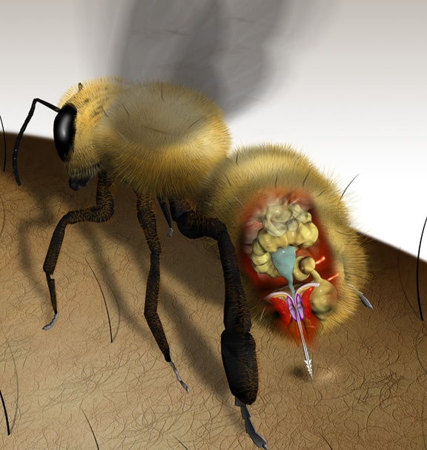
Bee Stings and Stingers
The bee's sting is speculated to have evolved for inter-bee combat between members of different hives, and the barbs serve to improve penetration of the chitin
(http://www.absoluteastronomy.com/topics/Bee_sting)
<number>

Slide 11
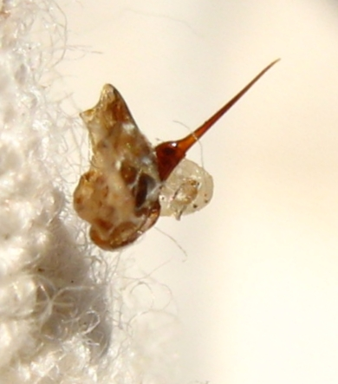
Bee Stings and Stingers
A stinger is a common head term for a sharp organ or body part found in various animals or plants that usually delivers some kind of venom.
Some stingers are barbed so that it lodges in the victim's skin.
The sting's injection of apitoxin into the victim is accompanied by the release of alarm phermones, a process which is accelerated if the bee is fatally injured and this will attract other bees to the location, where they will likewise exhibit defensive behaviors until there is no longer a threat, typically because the victim has either fled or been killed.
These pheromones do not dissipate or wash off quickly, and if their target enters water, bees will resume their attack as soon as it leaves the water.
<number>
(http://www.absoluteastronomy.com/topics/Bee_sting)

Slide 12
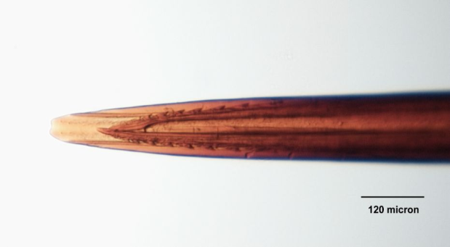
Bee Stings and Stingers
Each bee sting delivers up to 50 microgram of venom.
The main component of bee venom responsible for pain in vertabrates is the toxin melittin; histamine and other biogenic amines may also contribute to pain and itching.
In most cases, when a victim is stung by a bee, the stinger will remain in the skin and pump additional venom into the victim.
Non-allergic victims may require up to 1000 stings or 8.6 stings per pound of body weight in order to be risk of death (around 500 stings for children).
(http://www.absoluteastronomy.com/topics/Bee_sting)
<number>

Slide 13
Bee Stings and Stingers
Honey Bee stingers are barbed.
Chemical in venom is called melittin.
Wasp stingers are not barbed, and thus can sting multiple times
Deliver a venom that causes pain when injected into the skin.
<number>

Slide 14
Bee Stings and Stingers
The stinger is tearing off and remains in the skin
2 minutes later
6 minutes later - after the sting has been removed
27 minutes later
<number>

Slide 15
Bee Stings and Stingers
Bees can only sting once?
Stingers can be used several times when defending nests from small predators (other bees)
Defending against humans: the stinger is broken off of the bee and often tears the abdomen which results in the bee’s death.
<number>

Slide 16
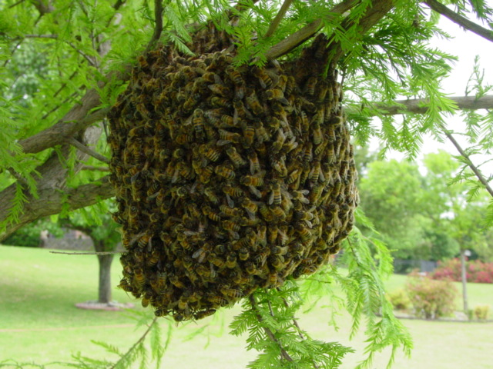
Bee Swarms
Swarm describes a behavior of an aggregate of animals of similar size and body orientation, often moving en mass in the same direction. "Swarming" is a general term that can be applied to any animal that swarms. Swarms of bees exhibit defensive behaviors until there is no longer a threat, typically because the victim has either fled or been killed.
http://www.absoluteastronomy.com/topics/Bee_sting
<number>

Slide 17
Effects of Bee and Wasp Stings
Very few victims experience the severe allergic reaction to the wasp sting and become fatal.
When the allergic victim is stung, the body releases the histamine not only to the local wound, but throughout the body which results in swelling, redness, pain and itching to occur not only on the skin but also in internal organs.
Life threatening effects include lungs filling with fluid, the esophagus swelling to the point of breathing blockage, and blood pressure dramatically dropping resulting in anaphylaxis shock.
<number>

Slide 18
Bees as a Construction Safety Hazard
Because many construction operations require the clearing of wooded areas, encounters with wasps and bees is common.
In order to protect workers from stings, the following, general precautions should be taken:
Long-sleeved shirts and pants should be worn during clearing operations.
Insect repellent should be considered.
If a nest is discovered, proper precautions should be taken in order to alleviate the hazard.
Pre-clearing inspections should be performed.
<number>

Slide 19
Bee and Wasp Sting Fatalities and Injuries
By the numbers
In the United States, 90-100 people die a year from bee and wasp venom.
(Ricky L. Langley, MD, MPH, Wilderness and Environmental Medicine, 16, 67 74 (2005))
Deaths normally occur within 1 hour of the sting so immediate first aid care should be sought.
http://ohioline.osu.edu/aex-fact/192/pdf/0192_1_03.pdf
Perhaps millions of painful, but harmless stings occur each year.
<number>

Slide 20
Bee and Wasp Sting Fatalities and Injuries
By the numbers
The average person can safely tolerate 10 stings for each pound of body weight. This means that the average adult could withstand more than 1,000 stings, whereas 500 stings could kill a child.
However, 1 sting can cause death from an anaphylactic reaction (a life-threatening allergic reaction in which blood pressure falls and the airway closes in a person who is allergic to such stings. )
In the United States, 3 or 4 times more people die from bee stings than from snakebites.
1% of the population is allergic to the venom of stinging insects like bees and wasps.
http://www.merck.com/mmhe/sec24/ch298/ch298g.html
<number>

Slide 21
Case Study 1:
A worker was clearing brush with a dozer along a fence line on a ranch.
He was found approximately one mile away from the dozer that he had been operating.
The body was found with approximately 1000 bee stings.
The dozer engine was still running and the front end of the dozer was against a tree.
He had received the bee stings sometime between 10:00 a.m. and 11:30 a.m. that morning. A swarm of bees was found in the approximate vicinity of the dozer.
<number>

Slide 22
Case Study 2:
An experienced hydraulic excavator operator was clearing trees and brush with a track hoe on a warm summer day. Dozers were also assisting in this effort by moving accumulated debris. He had been warned there might be bees in the brush. He stated that because he "swells up" when stung, he would shut the windows. At 11:30 a.m., the foreman drove to the site to monitor the work and, after seeing the machine parked, assumed the operator was eating lunch. Then he saw the operator lying on the ground by the left track of the machine. He was unable to approach due to bee activity. The operator appeared lifeless. EMS arrived 30 minutes later and donned full turnout gear to get the employee to an ambulance. By that time, he was cyanotic (a bluish or purplish discoloration of the skin due to deficient oxygenation of the blood) and was observed to have dozens of bee stings about the face, scalp, and hands. He died from anaphylactic shock.
<number>

Slide 23
Case Study 2:
Examination of the machine later revealed the driver's door window mechanism was broken and the window did not roll up tight. A 4-inch gap allowed bees to enter the cab, forcing the employee to flee. The employee had carefully parked the arm of the track hoe and turned off the ignition before exiting.
c
c
<number>

Slide 24
Case Study 3:
Two workers were in a workboat with an outboard motor and were manually picking up small pieces of debris, wood, etc. on the river banks. The workers encountered a wasp nest on a live tree limb over the river and the wasps attacked the employees. While attempting to get away from the wasps, they took their life jackets off and jumped into the river. One of the employees drowned.
<number>

Slide 25
OSHA Regulations:
Safety training and education- 1926.21(b)(1)
Provisions- Subpart D, 1926.50 (b)
First Aid Supplies- Subpart D, 1926.50 (d)
<number>

Slide 26
Best Practices:
<number>

Slide 27
What to do if stung:
First Aid for Bee and Insect Stings - Scrape the stinger out from the stung area—never squeeze or pull out the stinger.
Persons with severe allergic reactions to insect stings should consider wearing a medical ID bracelet and carrying an insect allergy kit where appropriate.
The Check List…
1. Have someone stay with the victim to be sure that they do not have an allergic reaction.
2. Wash the site with soap and water.
3. The stinger can be removed using a 4x4-inch gauze wiped over the area or by scraping a fingernail over the area. Never squeeze the stinger or use common tweezers. It will cause more venom to go into the skin and injure the muscle.
4. Apply ice to reduce the swelling.
5. Do not scratch the sting. This will cause the site to swell and itch more, and increase the chance of infection.
http://nasdonline.org/document/962/d000800/first-aid-for-bee-and-insect-stings.html)
<number>

Slide 28
What to do if stung and allergic:
Allergic reactions to bee stings can be deadly.
People with known allergies to insects stings should always carry an insect sting allergy kit and wear a medical ID bracelet or necklace stating their allergy.
See a physician about getting either of these.
There are several signs of an allergic reaction to bee stings:
1. Look for swelling that moves to other parts of the body, especially the face or neck.
2. Check for difficulty in breathing, wheezing, dizziness or a drop in blood pressure.
3. Get the person immediate medical care if any of these signs are present.
It is normal for the area that has been stung to hurt, have a hard swollen lump, get red and itch. There are kits available to reduce the pain of an insect sting. They are a valuable addition to a first aid kit.
(http://nasdonline.org/document/962/d000800/first-aid-for-bee-and-insect-stings.html)
<number>

Slide 29
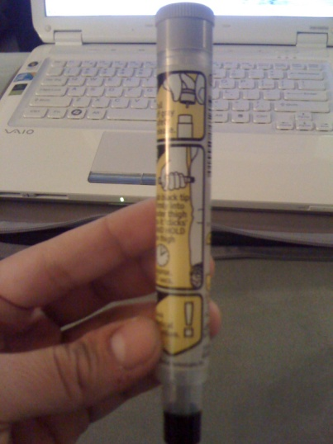
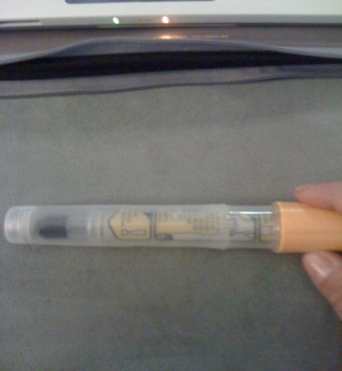
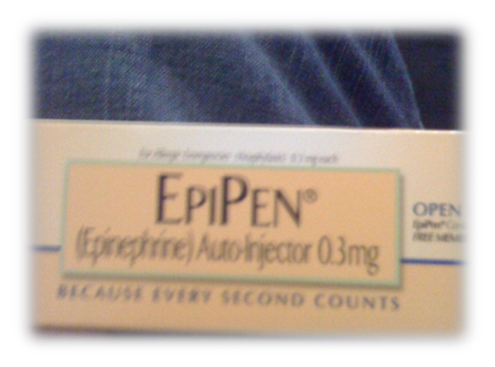
EpiPen or (Epinephrine)
What to do if stung and allergic:
How to use :
1. Pull off gray safety release.
2. Jab black tip firmly into outer thigh so it “clicks” and hold on thigh. Approx 10 sec.
3. Seek medical attention !
<number>

Slide 30
Precautions to take:
Wear clothing to cover as much of the body as possible.
Wear proper face, hand, and body protection ( mask, goggles, gloves etc.)
Keep work areas clean (Insects thrive in places where humans leave food).
Pre-clearing inspections should be performed.
If a nest is present, precautions should be taken in order to eradicate the hazard.
Remain calm and still
Wear light-colored, smooth-finished clothing.
Avoid perfumed soaps, shampoos, and deodorants.
Don't wear cologne or perfume.
Avoid bananas and banana-scented toiletries.
Wear clean clothing and bathe daily (Sweat may anger bees.)
Workers with a history of severe allergic reactions to insect bites or stings should consider carrying an epinephrine auto injector (EpiPen)
<number>

Slide 31
Precautions to take:
Employers should protect their workers from stinging insects by training them about:
Their risk of exposure
Insect identification
How to prevent exposure
What to do if stung
<number>

Slide 32
If attacked by several stinging insects at once, run to get away from them (Bees release a chemical when they sting, which may attract other bees.)
Go indoors.
A shaded area is better than an open area to get away from the insects.
If able to physically move out of the area, do not to attempt to jump into water. Some insects (particularly Killer Bees) are known to hover above the water, continuing to sting once you surface for air.
<number>
Notes:
<number>

Slide 33
If a bee comes inside vehicle, stop the car slowly, and open all the windows.
Workers with a history of severe allergic reactions to insect bites or stings should consider carrying an epinephrine auto injector (EpiPen) and should wear a medical identification bracelet or necklace stating their allergy.
<number>
Notes:
<number>

Slide 34
First Aid:
If a worker is stung by a bee, wasp, or hornet:
Have someone stay with the worker to be sure that they do not have an allergic reaction.
Wash the site with soap and water.
Remove the stinger using gauze wiped over the area or by scraping a fingernail over the area.
Never squeeze the stinger or use common tweezers.
Apply ice to reduce swelling.
Do not scratch the sting as this may increase swelling, itching, and risk of infection.
<number>
Notes:
<number>

Slide 35
Think safety
Work Safely
<number>

